Slide 1
M2M Service Architecture 物聯網服務架構
行動寬頻尖端技術跨校教學聯盟
國立交通大學資訊工程系
Department of Computer Science
National Chiao Tung University
October 13, 2016

Slide 2














M2M Service Architecture
Client Applications
M2M Area Network
M2M Core Network
M2M
Device
Service
Capabilities
M2M
Gateway
Service
Capabilities
M2M
Network
Service
Capabilities
M2M
Gateway
M2M Applications
M2M Device Domain
M2M Network Domain
M2M Application Domain
IoT/M2M Service Platform
Notes:
M2M服務架構– 位於M2M核心網路後端並延伸至M2M閘道及設備

Slide 3
Outline
M2M Common Service Layer
REST Architectural Style for M2M
Resource-Based M2M Communications
Notes:
大綱
M2M服務功能框架
REST架構風格的M2M
基於資源的M2M通訊

Slide 4
M2M Common Service Layer
Notes:
M2M服務功能框架

Slide 5
oneM2M Network
Application Dedicated Node
Cloud
A Distributed Application Platform for IoT/M2M
Source: oneM2M
Infrastructure Node
AE
e.g. BLE
AE
AE
Application Service Node
Middle Node
Cloud
API
AE
AE
AE
oneM2Mmessages
oneM2Mmessages
API
API
API
CSE
e.g. WLAN, Zigbee
CSE
e.g. WWAN
CSE
Field Domain
Infrastructure Domain
Notes:
oneM2M 網路架構
oneM2M 標準定義了以下幾種node:
Infrastructure Node – 包含一個CSE與零個以上的AE, IN 通常在M2M Service Infrastructure
Middle Node –包含一個CSE與零個以上的AE, MN 在 Gateway
Application Service Node(ASN) -包含一個CSE與一個以上的AE, ASN 在 Device
Application Dedicated Node(AND) - 只包含一個CSE. ADN在 constrained M2M device

Slide 6
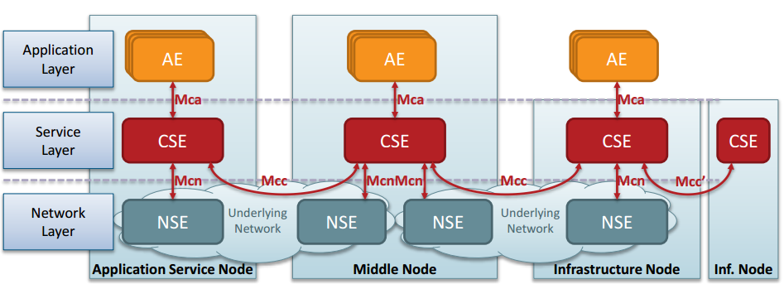
oneM2M Functional Architecture
AE: Application Entity
CSE: Common Service Entity
NSE: Network Service Entity
A Distributed Application Platform for IoT/M2M
Source: oneM2M
Notes:
oneM2M 基礎架構
Mca – AE 與 CSE的溝通會跨過 Mca
Mcn – NSE 與 CSE的溝通會跨過 Mcn
Mcc – CSE 與 CSE的溝通會跨過 Mcn
Mcc’ – 不同的infrastructure domain的CSE的溝通會跨過 Mcc’

Slide 7
Release 1 Technical Specifications
TS-0001 Functional Architecture
TS-0003 Security Solution
TS-0004 Service Layer Core Protocol
TS-0002 Requirements
TS-0009 HTTP Protocol Bindings
TS-0008 CoAP Protocol Bindings
TS-0010 MQTT Protocol Binding
TS-0006 Managements Enablement (BBF)
TS-0005 Management Enablement (OMA)
TS-0011 Acronyms and Definitions
Release 1 was released on February 4, 2015.
Notes:
第一版 技術標準
onem2m release1 所出版的標準文件

Slide 8
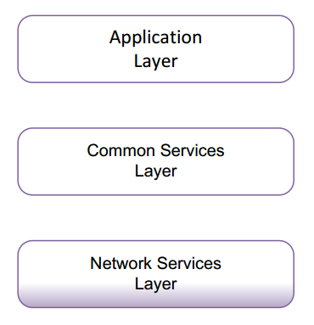
Functional Architecture
It describes the end-to-end oneM2M functional architecture, including:
Functional entities, and
Reference points.
It focuses on the Service Layer aspects.
Underlying Network-independent view of the end-to-end services.
The Underlying Network is used for the transport of data and potentially for other services.
Source: oneM2M TS-0001
Notes:
基礎架構
基礎架構分為三層 application layer, common service layer and network services layer.
每層內包含 functional entities, 各層之間都有reference point (ex: Mca, Mcc…)

Slide 9
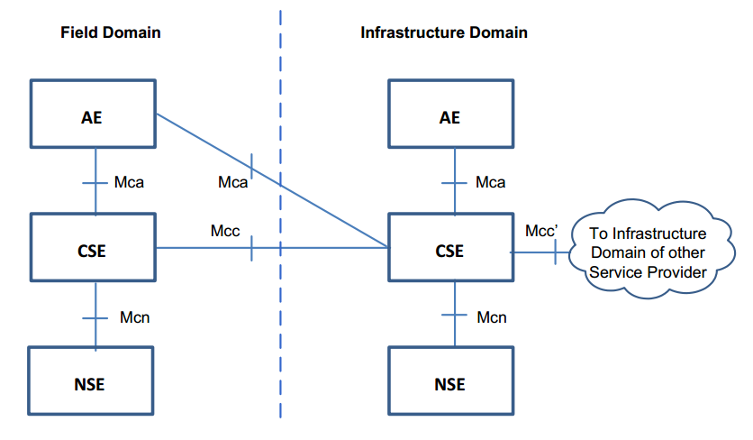
Functional Architecture (2)
Source: oneM2M TS-0001
Note: Mch and mc, mo, ms, Ia reference points not shown
Notes:
基礎架構(2)
這張圖展示 field domain 的node 與 infrastructure domain 的node.
每個node 裡面會有NSE, CSE 與AE. Entity 之間也會有reference point相接.

Slide 10
Functional Entities
Application Entity (AE): Application Entity represents an instantiation of Application logic for end-to-end M2M solutions.
Common Services Entity (CSE): A Common Services Entity represents an instantiation of a set of “Common Service Functions" (CSFs) of the M2M environments.
Network Services Entity (NSE): A Network Services Entity provides services from the Underlying Network (UN) to the CSEs.
Underlying Networks provide data transport services between entities in the oneM2M System. Such data transport services are not included in the NSE.
Notes:
Functional Entities
AE – 代表提供 m2m服務的應用程式。
CSE – 代表一組的 共同服務函式，這些函數可以提供m2m中所需的共同基礎功能。
NSE – 提供底層網路服務給CSE。 底層網路提供資料傳輸功能，但這些資料傳輸功能並不包含魚NSE中。

Slide 11
Reference Points (1)
Mca, It enables the AE to use the services supported by the CSE, and for the CSE to communicate with the AE.
Mcn, It enables a CSE to use the supported services (other than transport and connectivity services) provided by the NSE.
Notes:
Reference Points(1)
Mca: 透過這個reference point, AE可以使用CSE所提供的服務，他們之間也能進行溝通。
Mcn:透過這個reference point, CSE可以使用NSE所提供的服務。

Slide 12
Reference Points (2)
Mcc, it enables a CSE to use the services supported by another CSE. Either on the same or different domains.
Mcc’, It enables a CSE of an infrastructure node residing in the Infrastructure Domain of an M2M Service Provider to communicate with a CSE of another infrastructure node residing in the Infrastructure Domain of another M2M Service Provider to use its supported services, and vice versa.
Notes:
Reference Points(2)
Mcc: 透過這個reference point, CSE可以使用CSE所提供的服務
Mcc’: 透過這個reference point, 不同的infrastructure domain的CSE可以進行溝通

Slide 13
Reference Points (3)
Mch, Communication flows which transfer Charging Data Record (CDRs) generated by the Infrastructure Node (IN) to an external charging server cross the Mch reference point.
The Mch reference point may be mapped to reference points of other specifications, e.g. Rf reference point on a 3GPP Underlying Network.
Notes:
Reference Points(2)
Mch: IN 會傳送 charging data record 到外部的charging server

Slide 14
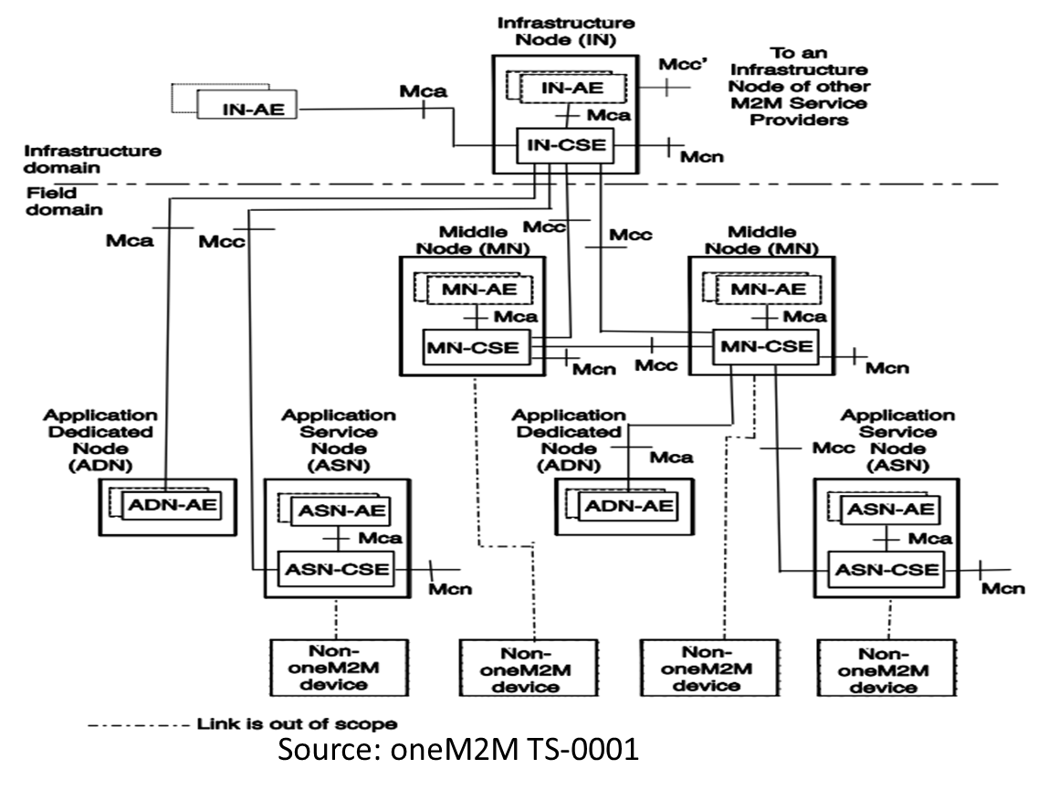
Overall oneM2M Functional Architecture
Notes:
這是一個完整的onem2m 基礎功能架構圖

Slide 15
Types of oneM2M nodes
CSE-Capable Node is a functional entity that contains one oneM2M Common Services Entity and zero or more oneM2M Application Entities.
Application Service Node (ASN)
Middle Node (MN)
Infrastructure Node (IN)
Non-CSE-Capable Node is a functional entity that contains one or more oneM2M Application Entities and no oneM2M Common Services Entity.
Application Dedicated Node (ADN)
Application Entity at Infrastructure Domain
Notes:
oneM2M nodes 可分為兩大類:
(1) CSE-capable node: 這類的entity會包含1個CSE和0個或以上的AE.
(2) Non-CSE-Capable Node:這類的entity會包含1個以上的AE且不包含任何CSE

Slide 16
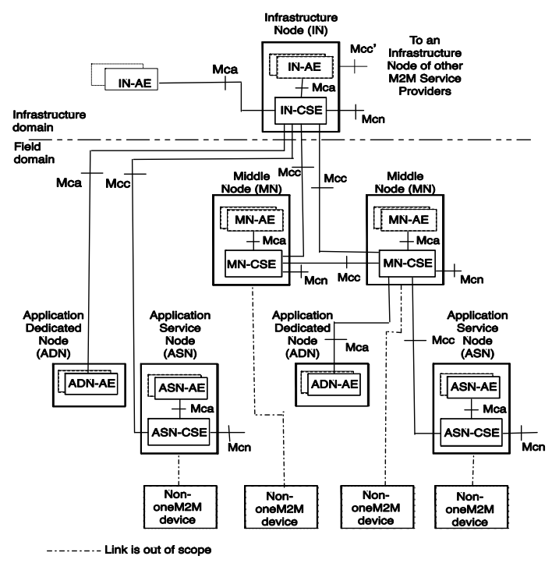
Infrastructure Domain
Only one logical IN in the Infrastructure Domain per oneM2M Service Provider of an
M2M System
Notes:
在m2m 系統中，每個有一個service provider的infrastructure domain內, 應該只會有一個IN。

Slide 17
Field Domain (1)
IN @ Infrastructure Domain
Notes:
在field domain中，你可以擁有很多個middle node。

Slide 18
Field Domain (2)
IN @ Infrastructure Domain
MN @ Field Domain
Mca
Mcc
Notes:
在field domain, 也會有 ASN或是ADN, 他們可以跟 infrastructure domain的CSE或是同一個field domain的CSE相連。

Slide 19
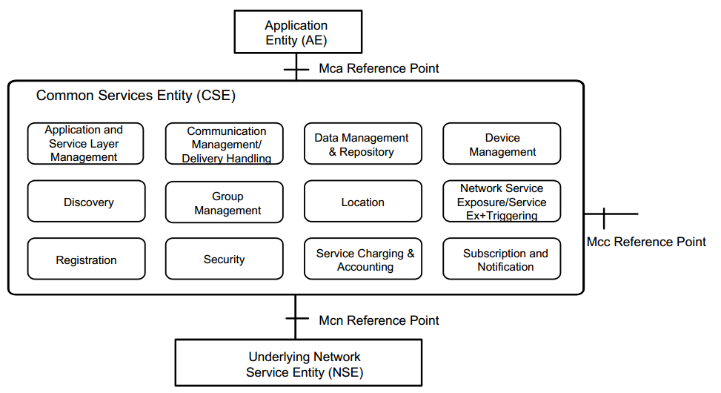
Common Service Functions (1)
Source: oneM2M TS-0001
Notes:
Onem2m共訂定了12種共同服務功能(Common Service Functions)，各功能詳細定義可以查閱oneM2M標準 TS-0001 6.2 Common Service Functions

Slide 20
Common Service Functions (2)
CSF1
CSF8
CSF2
Routing
Function
CSF7
CSF3
CSF4
CSF6
CSF5
Notes:
此圖顯示共同服務功能的軟體結構，這些共同服務功能通常依靠一個路由功能來做連結，當信號進到系統後，會依序由不同的服務功能來處理，一個服務功能處理完信號後就會藉路由功能傳遞到下一個服務功能來處理

Slide 21
Abbreviation of CSFs
ASM – Application and Service Layer Management CSF
CMDH – Communication Management and Delivery Handling CSF
DMR – Data Management and Repository CSF
DMG – Device Management CSF
DIS – Discovery CSF
GMG – Group Management CSF
LOC – Location CSF
NSSE – Network Service Exposure, Service Execution and Triggering CSF
REG – Registration CSF
SEC – Security CSF
SCA – Service Charging and Accounting CSF
SUB – Subscription and Notification CSF
Notes:
CSFs的縮寫

Slide 22
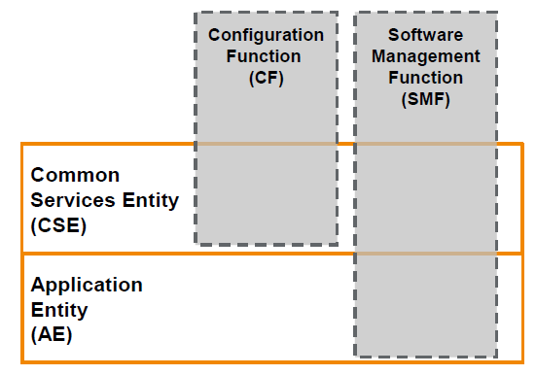
Application and Service Layer Management (ASM)
Management of AEs and CSEs on the
Application Dedicated Nodes,
Application Service Nodes,
Middle Nodes and
Infrastructure Nodes
It is divided into two functions:
Configuration Function (CF)
Software Management Function (SMF)
CF only applies to CSE, while SMF works on both CSE and AE.
SMF manages software component for application and CSE including the state of the software package
Management is done through role based permissions.
Notes:
Application and Service Layer Management(ASM)
ASM負責管理各個node裡面的AE與CSE。
ASM又可以分為CF與SMF。
其中CSF只用在CSE，而SMF則可以用在CSE與AE。
SMF管理AE和CSE的軟體套件與其狀態。
管理可以透過基於角色的權限來達成。

Slide 23
Communication Management and Delivery Handling (CMDH)
It enables the communication among CSE, AE, NSE.
It determines which communication connection to use, and when to buffer request for later (Delivery Handling).
Characteristics
Need to access to provisioned delivery handling policies
Allow to store requests
Processing based on provisioned policies and delivery handling parameters
Transparent data delivery
Management through role based permissions
Notes:
Communication Management and Delivery Handling
他使CSE, AE and NSE之間能夠溝通。
他決定使用哪一條溝通的連線，或是暫時緩衝後再傳送。
特徵:
需要訪問配置的delivery handling政策
允許儲存請求
基於配置的策略和delivery handling參數來處理
透明的數據傳遞
通過基於角色的權限進行管理

Slide 24
IP based protocols
HTTP (TS-0008)
Method is mapped to the oneM2M operation parameter
Request-URI is derived from the oneM2M to parameter
Status-Code and Reason-Phrase are derived from the oneM2M
responseStatusCode parameter of the response primitive
This specification supports binding to HTTP 1.1
CoAP (TS-0009)
Support of blockwise transfers
Caching is supported using freshness and validity information carried with CoAP responses
Due to limited code field in CoAP, some oneM2M response code shall be carried via CoAP payload field
MQTT (TS-0010)
Two scenarios for MQTT server location: MQTT server co-located within a node (MN, IN), and MQTT server located independently from nodes
The received resource representation shall be in in plain XML, binary XML or JSON
Notes:
IP based protocols
標準中關於IP-based 的協定包含 HTTP, CoAP and MQTT，都可以在相對應得標準中去查閱更詳細的描述。

Slide 25
Data Management and Repository (DMR)
It provides data storage and mediation to the M2M entities.
Characteristics:
It grants access based on access control policies.
It is able to aggregate data from different entities.
Data conversion into specific format for analysis and semantic processing.
Data can be raw or processed by intermediate node.
Support transfer of data to/from the AEs and other CSEs
Provide a means to perform analytics on large amount of data.
Provide semantic information and enable functions for annotation
Expose M2M resources based on semantic information.
Enable application to discover and interpret M2M data from different sources.
Notes:
Data Management and Repository (DMR)
它向M2M實體提供資料存儲和中介。
特性:
它基於access control策略授予訪問權限
它能夠聚合來自不同實體的數據。
數據轉換為特定格式用於分析和語義處理。
數據可以是原始的或由中間節點處理。
支持向AE和其他CSE傳輸數據
提供對大量數據執行分析的方法。
提供語義信息並啟用註釋功能
基於語義信息顯露M2M資源。
使用應用程式以便從不同來源發現和解釋M2M數據。

Slide 26
Device Management and Repository (DMG) - 1
To manage the device capabilities on
Middle Nodes (M2M Gateways),
Application Service Nodes
Application Dedicated Nodes reside
within an M2M Area network
Utilize existing device management technologies
TR‑069, OMA-DM, and LWM2M
Notes:
Device Management - 1
去管理M2M 區域網路中 MN, ASN, AND的能力。
Device Management 會使用現有的device management 技術，
例如: TR-069(https://en.wikipedia.org/wiki/TR-069), OMA-DM(https://en.wikipedia.org/wiki/OMA_Device_Management), LWM2M(https://en.wikipedia.org/wiki/OMA_LWM2M)等

Slide 27
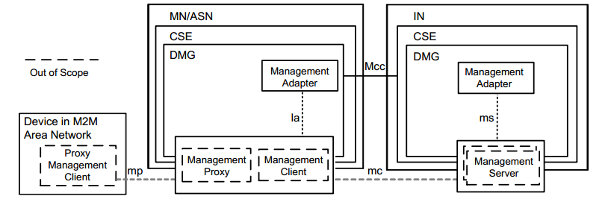
Device Management and Repository (DMG) - 2
Device Management Architecture
Source: oneM2M TS-0001
Management Adapter performs translation and adaptation between the DMG and
the management technology
Interacting with the management server over ms or la interfaces
Through this CSF, an AE does not need to know the device management technology of the devices
since DMG will handle the command translation accordingly.
Notes:
Device Management - 2
Management Server 可以在IN內也可以在IN之外。
la interface允許不只是 m2m 區域網路的裝置管理，也可以允許管理MN, ASN。
Management Server can be out side or inside the IN.
LA interface allows not just M2M area network management but also MN , ASN management

Slide 28
Device Management and Repository (DMG) - 3
DMG capabilities are divided into:
Device Configuration Function
Discovery of a device's management objects and attributes
Ability to enable or disable a device capability
Provisioning configuration parameters of a device
Device Topology Management Function
Management of the topology of the M2M Area Network
Device Diagnostics and Monitoring Function
Troubleshooting through the use of diagnostic tests, alert generation
Retrieval of operational status and statistics associated
Device Firmware Management Function
Software lifecycle management for firmware components
Notes:
Device Management – 3
DMG功能可以分為四種:
裝置配置
探索裝置的管理對象和屬性
能夠啟用或禁用裝置功能
給予裝置的配置參數
裝置拓樸管理
裝置診斷與監控
通過使用診斷測試，警報生成進行故障排除
檢索相關的操作狀態和統計信息
裝置上韌體的生命週期管理

Slide 29
Device Management and Repository (DMG) - 4
Reuse device management capabilities defined by OMA (Open Mobile Alliance) and BBF (Broadband Forum)
oneM2M-TS-0005 specifies the usage of OMA DM and OMA LWM2M resources.
oneM2M-TS-0006 specifies the usage of the BBF TR-069 protocol.
Notes:
Device Management – 4
在oneM2M 標準 TS-0005 有描述如何整合 OMA DM 與 OMA LWM2M。
在oneM2M 標準 TS-0006 有描述如何整合 BBF 所提出的 TR-069協定。

Slide 30
Discovery (DIS)
Provides discovery of information/resources residing in a local or multiple remote CSE(s).
Supported attributes and resources
Permission required
Supports various discovery methods through the use of "filter criteria"
Keyword, identifiers, location, semantic information
Subject to access control policies and filter criteria specified by the Originator in the discovery request
Response includes actual discovered information or resource address(es)
Discovery is based on the capabilities defined through the device configuration function
Notes:
Discovery(DIS)
可以透過這個功能去探索local端或是遠方CSE裡的resource與相關資訊。
可以加上filter criteria 去過濾想要的資訊，但也必須遵守access control policies的限制。
回復就必須包含想要探索資訊與資源位址。
裝置配置函式則定義discovery可以做得的能力。

Slide 31
Group Management (GMG)
Responsible for handling Group related requests.
Bulk operations includes read, write, subscribe, notify, device management, etc.
Access control is facilitated by grouping.
May rely on broadcast and multicast network capabilities.
Support subscriptions to individual Groups.
Management of a Group and its membership
Allow to create, query, update, and delete a Group
Allow to retrieve the information (e.g. URI, metadata, etc.) of a Group and its associated members
Allow to add or remove members to and from a Group's member list
Only M2M Applications or CSEs with common role shall be included in the same Group
role based access control
Notes:
Group Management (GMG)
負責處理群體相關請求。
批量操作，包含read, write, subscribe, notify, device management 等等。
透過grouping 來促進 access control。
可能需要依賴 broadcast 和 multicast 網路的功能。
支援對單一group做訂閱。
管理group 與其成員。
只有具有共同角色的M2M AE或CSE可以包括在同一group中。

Slide 32
Location (LOC)
It allows AEs to obtain location information of M2M entities such a ASN, MN, etc.
Location information could be more than latitude and longitude coordinates.
To obtain location information, this CSF interacts with:
GPS module on devices
Location technology from the Underlying Network (if available)
Location information existent in the node themselves.
It is also responsible of protecting confidentiality of geographical location information.
Notes:
Location (LOC)
它允許AE獲得如ASN，MN等的M2M實體的位置信息。 位置信息可以包含不只緯度和經度坐標。 為了獲得位置信息，該CSF與以下各項互動：
GPS模組
來自底層網路的位置技術
存在節點裡的位置資訊
他也負責保護地理位置資訊的機密性。

Slide 33
Network Service Exposure, Service Execution and Triggering (NSSE)
Manages communications with the Underlying Networks for accessing network service functions over the Mcn reference point.
The network service functions provided by the Underlying Network include service functions such as:
device triggering, small data transmission, location notification, policy rules setting, location queries, IMS services, device management, etc.
Such services do not include the general transport services
For example, for the 3GPP networks, to provide the network services based on control plane signaling mechanisms
It may have interface to 3GPP components such as PCRF, ANDSF and HSS.
Hide the underlying network technology from the AN and CSF
Notes:
Network Service Exposure, Service Execution and Triggering (NSSE)
管理透過Mcn與底層網路的溝通以便去使用網路服務。
NSSE CSF 會隔離 AEs與CSFs 和底層網路所支援的技術。

Slide 34
Registration (REG)
Handling an Application or another CSE to register with a CSE in order to allow the registered entities to use the services offered by the registered-with CSE.
CSE in the field domain shall register with the CSE in the infrastructure domain.
Enabling peering relationship
Application in both domains shall register with local CSE.
Registration information include
ID
Reachability schedule
If the later is not present, it will assume the resource is always available.
Notes:
Registration(REG)
處理AE或是其他CSE去註冊到CSE以便去使用這個CSE所提供的服務。
在field domain的CSE都應該像在infrastructure domai的CSE註冊。
所有的AE都應該像他的local CSE註冊。
註冊資訊應該包含 ID 與 Reachability Schedule。
Reachability Schedule 代表一個node的policy，規定什麼時候可以傳輸訊息在nodes之間，若是沒有定義這個部分，就代表任何時候都允許。

Slide 35
Security (SEC)
Sensitive Data Handling functionality
Protects the local credentials on which security relies during storage and manipulation.
Several cryptographically separated security environments.
Security Administration functionality
Creation and administration of dedicated security environment
Post-provisioning of a root credential
Provisioning and administration of subscriptions related to M2M Services
Security Association Establishment functionality
Between corresponding M2M nodes
Authorization and Access Control functionality
According to provisioned security policies and assigned roles
Identity Protection Functionality
Unique identifier
Support pseudonym identifier without linking to true identity
Notes:
Security(SEC)
敏感資料的處理
安全環境的管理
安全連結的建立
根據 access control政策來授權
身分的保護

Slide 36
Service Charging and Accounting (SCA)
It provides charging functions for the Service Layer.
Support online and offline charging
Capturing chargeable events, recording of information, generating charging records and charging information
Multiple charging models: subscription based, event based charging (e.g. based on create, update and retrieve), session based charging, service based charging
It supports:
Independent Service Layer Charging (M2M SL), and
Correlated charging (M2M SL and UN)
It is divided into three functions:
Charging Management Function
Charging Triggering Function
Offline Charging Function
Notes:
Service Charging and Accounting(SCA)
它為服務層提供計費功能。
支援線上線下的收費。 捕獲可計費事件，記錄資訊，生成計費記錄和計費資訊。
多個計費模型：基於訂閱，基於事件的計費（例如基於創建，更新和檢索），基於會話的計費，基於服務的計費。 它支持：
獨立服務層計費（M2M SL）
相互關聯的收費（M2M SL和UN） 它分為三個功能：
收費管理功能
收費觸發功能
離線收費功能

Slide 37
Subscription and Notification (SUB)
Manage subscriptions to resources, subject to access rights, and send corresponding notifications to the watcher address(s).
Watcher address(s) represents the resource subscribers that want to receive the notification.
An AE subscribes to resources on a local or remote CSE.
A CSE subscribes to resources on multiple CSEs.
Subscription scope includes the subscribed resource, and its attributes and child nodes (however it does not include child nodes attributes)
It supports filter criteria and group subscription.
Subscription request includes Subscription ID, Hosting CSE-ID, Subscribed-to resource addresses, Criteria (optional), the address(s) for sending the notification.
Notes:
Subscription and Notification (SUB)
根據訪問權限管理對資源的訂閱，並將相應的通知發送到觀察程序地址。
觀察者地址 作為 想要接收通知的資源訂閱者的代表。
AE訂閱本地或遠程CSE上的資源。
CSE訂閱多個CSE上的資源。
訂閱範圍包括訂閱資源及其屬性和子節點（但不包括子節點屬性）。
它支持過濾條件和群體訂閱。
訂閱請求包括訂閱ID，訂閱目的地CSE-ID，訂閱的資源地址，條件（可選），發送通知的地址。

Slide 38
REST Architectural Style for M2M
Notes:
M2M的REST架構風格

Slide 39
What’s REST?
REST (REpresentational State Transfer)
The term representational state transfer was introduced and defined in 2000 by Roy Fielding in his doctoral dissertation.
Conforming to the REST constraints is generally referred to as being "RESTful”.
Notes:
The term representational state transfer was introduced and defined in 2000 by Roy Fielding in his doctoral dissertation. Fielding is one of the principal authors of the Hypertext Transfer Protocol (HTTP) specification versions 1.0 and 1.1.[
什麼是“REST”？
‧REST（REpresentational State Transfer）
–「表示性狀態轉移 」此術語在2000年由Roy Fielding於其博士論文中介紹與定義。
–符合REST限制通常被稱為“REST式”。

Slide 40
Representational State Transfer
In REST, requests and responses are built around the transfer of representations of resources. A representation of a resource is typically a document that captures the current or intended state of a resource.
Notes:
表示性狀態轉移
‧在REST中，請求與回應都建立在資源的表示性轉移。資源的表示性是一個典型的文件，用以記錄當前或預期的資源狀態。

Slide 41
REST Architectural Style
The REST architectural style imposes certain constraints, while leaving the implementation of the individual components free to design.
The key goals are
Scalability of component interactions
Generality of interfaces
Independent deployment of components
Intermediary components to reduce latency, enforce security and encapsulate legacy systems
Notes:
REST架構風格
‧REST架構風格施加一定的限制，但同時允許獨立組件的實現可以自由設計。
‧主要目標：
–組件交互作用的可擴展性
–介面的通用性
–組件的獨立部署
–利用中間組件，達到減少延遲，加強安全性和封裝遺留系統

Slide 42
REST Constraints (1)
Client–server with a uniform interface separating clients from servers.
Clients are not concerned with data storage, which remains internal to each server, so that the portability of client code is improved.
Servers are not concerned with the user interface or user state, so that servers can be simpler and more scalable.
Servers and clients may also be replaced and developed independently, as long as the interface between them is not altered.
Stateless: The client–server communication is further constrained by no client context being stored on the server between requests. Each request from any client contains all of the information necessary to service the request, and any session state is held in the client
Source: Wikipedia
Notes:
REST限制 ( 1 )
客戶端 – 伺服器：一個統一的介面，將客戶端與伺服器分離。
–客戶端不用擔心資料的存儲，因為每一個伺服器的內部都會處理資料存儲，因此提升客戶端程式的可移植性。
–伺服器不用擔心使用者介面或狀態，使伺服器可以更簡單且可擴展性更高。
–伺服器和客戶端也可以個別的被替換和開發，同時保持它們之間的介面沒有改變。
無狀態 (Stateless)：
藉由在請求之間，伺服器上不存儲任何客戶端的狀態，達到進一步限制客戶端 -伺服器通信。
任何客戶端發出的請求中皆含有處理請求所需的所有資訊，且客戶端保存所有會話狀態。

Slide 43
REST Constraints (2)
Cacheable: In REST, clients can cache responses. Responses from the servers must therefore, implicitly or explicitly, define themselves as cacheable or not, to prevent clients reusing stale or inappropriate data in response to further requests. Well-managed caching partially or completely eliminates some client–server interactions, further improving scalability and performance.
Layered system - A client cannot ordinarily tell whether it is connected directly to the end server, or to an intermediary along the way. Intermediary servers may improve system scalability by enabling load-balancing and by providing shared caches. They may also enforce security policies.
Source: Wikipedia
Notes:
REST限制 ( 2 )
可暫存状態：
–在REST中，客戶端可以暫存回應状態。
因此，來自伺服器的回應必須明示或暗示地將自己的狀態定義為是否可暫存，以防止客戶端重複使用陳舊或不適當的資料作進一步請求。
–管理良好的暫存策略能部分或完全地消除一些客戶端 –伺服器間不必要的交談 ，進一步提高可擴展性和效能 。
分層系統：
–客戶端通常不知道自己是否直接連到終端服務器，或是連到沿途的中介。
–中間伺服器可以藉由啟用負載均衡，提供共享的暫存，從而提升系統的可擴展性。它們也可以加強安全政策 。

Slide 44
REST Resources (1)
An important concept in REST is the existence of resources (sources of specific information), each of which is referenced with a global identifier (e.g., a URI in HTTP).
In order to manipulate these resources, components of the network (clients, proxies, servers etc.) communicate via a standardized interface (e.g., HTTP) and exchange representations of these resources (the actual documents conveying the information).
Notes:
REST資源 ( 1 )
．REST中的一個重要概念是資源（特定訊息的來源），其中資源都會各自參考到一個普世識別碼 （global identifier 例如HTTP中的URI）。
．為了運用這些資源，網路組件（客戶端，代理伺服器，伺服器等）透過標準化介面（如HTTP）互相溝通，並交換資源的表示（傳達資訊的實際文件）。

Slide 45
REST Resources (2)
For example, a resource that represents a circle (as a logical object) may accept and return a representation that specifies a center point and radius, but may also accept and return a representation that specifies any three distinct points along the curve (since this also uniquely identifies a circle) as a comma-separated list.
Any number of connectors (e.g., clients, servers, proxies, etc.) can mediate the request, but each does so without "seeing past" its own request (based on the REST constraint of "layering“ discussed before).
Notes:
REST資源 ( 2 )
．例如，代表一個圓(作為一個邏輯物件）的資源可以接受並傳回指定圓心和半徑的表示，但也可以接受並傳回表達成一個逗號分隔列表的沿著曲線之任意三個相異點（因為這樣也能畫出一個特定圓）的表示。
．任意數量的連接器（例如，客戶端，伺服器，代理伺服器等）可以來處理所收到請求，但每一個連接器無法“看到過去”自己的請求 (基於先前討論的REST限制：分層系統)。

Slide 46
REST Resources (3)
As a result, an application can interact with a resource by knowing two things: (1) the identifier of the resource and (2) the action required—it does not need to know whether there are caches, proxies, gateways, firewalls, tunnels, or anything else between it and the server actually holding the information. The application does, however, need to understand the format of the information (representation) returned, which is typically an HTML, XML or JSON document of some kind, although it may be an image, plain text, or any other content.
Notes:
REST資源 ( 3 )
．因此，藉由得知以下兩點：（1）資源的識別碼 （2）所需要的行動，一個應用程序可以與資源進行互動 — 它並不需要知道是否有暫存 、代理、閘道、防火牆、隧道或任何其它位在它們之間的東西。實際上伺服器保有這些資訊。
儘管回傳的資訊可能是一個圖像、純文本或任何內容，應用程序仍然需要了解回傳的資訊的格式（表示）。典型格式有HTML、XML或JSON文檔。

Slide 47
REST Interfaces (1)
The uniform interface any REST interface must provide:
Identification and representations of resources: Individual resources are identified in requests, for example using URIs in web-based REST systems. The resources themselves are conceptually separate from the representations that are returned to the client. For example, the server does not send its database, but rather, some HTML, XML or JSON that represents a few database records expressed in language and encoding, depending on the details of the request and the server implementation.
Notes:
REST 介面 (1)
任何REST介面都應提供的統一介面：
．資源的識別碼和表示：
請求中要確認每一單獨的資源，例如， 使用Web REST系統的 URIs。資源本身在概念上和回傳到客戶端的其表示是有所區隔的。
例如，伺服器並不會傳送自己的資料庫，而是傳送一些HTML、XML或JSON，其中內容是經過語言化且代碼化的部份資料庫紀錄。
至於要傳那些經 HTML、XML或JSON 表示的資源紀錄， 則取決於請求和伺服器實現的細節。

Slide 48
REST Interfaces (2)
Manipulation of resources via their representations: When a client holds a representation of a resource, including any metadata attached, it has enough information to modify or delete the resource on the server, provided it has permission to do so.
Self-descriptive messages: Each client-server message includes enough information to describe how to process the message. For example, which parser to invoke may be specified by an Internet media type (previously known as a MIME type). Responses also explicitly indicate their cacheability.
Notes:
REST 介面 (2)
．藉由資源的表示運用資源：
當客戶端擁有一個資源的表示(這包括附加的任何資料描述 metadata)，則客戶端即擁有足夠的資訊可以發出請求在伺服器上修正或刪除資源，當然前提是有得到可以這麼作的權限。
．自述性訊息：
每一則客戶端-伺服器間訊息含有足夠資訊描敘如何處裡這則訊息。
例如，網路媒體類型（也被稱為MIME類型）可能會指定需要喚醒哪一個解析器。而回應也會明確地表明自己的暫存能力。

Slide 49
Manipulation of Resources in REST
There are four basic operations:
CREATE
UPDATE
DELETE
READ
Each operation is composed of request and response messages
Both UPDATE and READ operations are idempotent.
Notes:
在 REST 進行資源操作
‧有四種基本操作：
–CREATE
–UPDATE
–DELETE
–READ
‧每個操作都是由請求和回應訊息所組成。
‧UPDATE和READ操作是冪等 (Idempotent)。

Slide 50
Idempotent Operations
The end result of the operation is unchanged no matter how many times the operation is repeated.
Due to no side effects,
Resources can be freely distributed.
Proxy functions can be freely inserted.
Implementation of REST in HTTP
CREATE => HTTP POST; READ => HTTP GET; UPDATE => HTTP PUT; DELETE => HTTP DELETE
Notes:
冪等的操作
．不論重覆操作多少次，操作的最後結果是不會改變的
．由於沒有副作用
–資源可以自由的分配
–可以自由的插入代理功能
．在HTTP中的REST實現：
CREATE => HTTP POST;
READ => HTTP GET;
UPDATE => HTTP PUT;
DELETE => HTTP DELETE

Slide 51
Why REST for M2M?
REST mapped well to M2M by modeling M2M sensor and devices as REST resources that have particular states to be manipulated.
The REST-based architecture allows visualization and manipulation of M2M sensors and devices using a web browser. It also allows web mash-ups of information from multiple M2M sensors and devices.
Furthermore, scalability is greatly improved because the states transferred to the client can be cached and each communication with the server is stateless. This is particularly true when a proxy is used to serve many M2M sensors or devices.
Large M2M applications can be developed using simple HTML and Javascript.
Notes:
為什麼在M2M中採用REST？
．藉由將M2M感測器和設備模組化成擁有可以被操作的特定狀態的REST資源，REST很好的映射到M2M。
．基於REST的架構允許經由Web瀏覽器對M2M感測器和設備作可視化和操縱。它也允許將來自多個M2M感測器和設備的資訊作網路mash-ups。
．此外，可擴展性大大提高，因為傳輸到客戶端的狀態可以被暫存 ，且每一個與伺服器的通訊是無狀態的。
當使用代理器來服務許多M2M感測器和設備時，尤其如此。
．可以使用簡單的HTML和Javascript開發大型M2M應用程序。

Slide 52
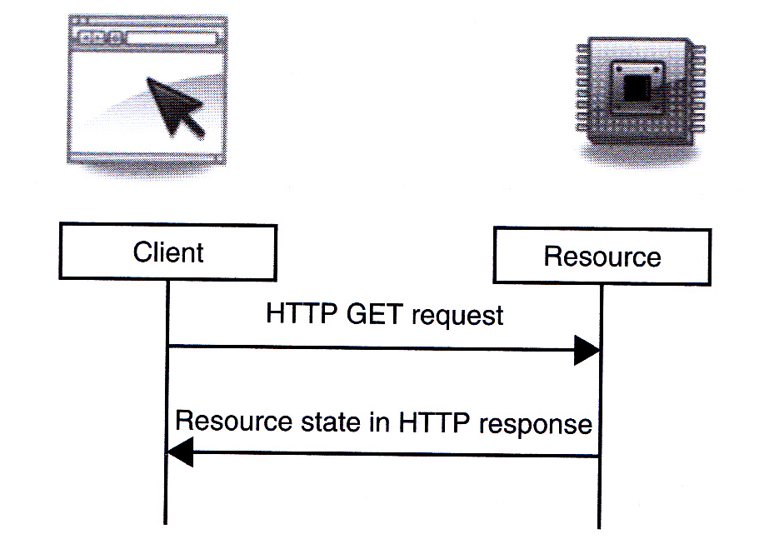
M2M REST – READ via HTTP GET
Source: M2M Communications: A Systems Approach, Wiley, 2012
This shows that HTTP GET request is used to read the state of an
M2M resource. The result is returned in an HTTP response.
Notes:
M2M REST –透過HTTP GET作READ
．這張圖表明HTTP GET請求是用來讀取M2M資源的狀態。返回一個內含結果的HTTP回應。

Slide 53
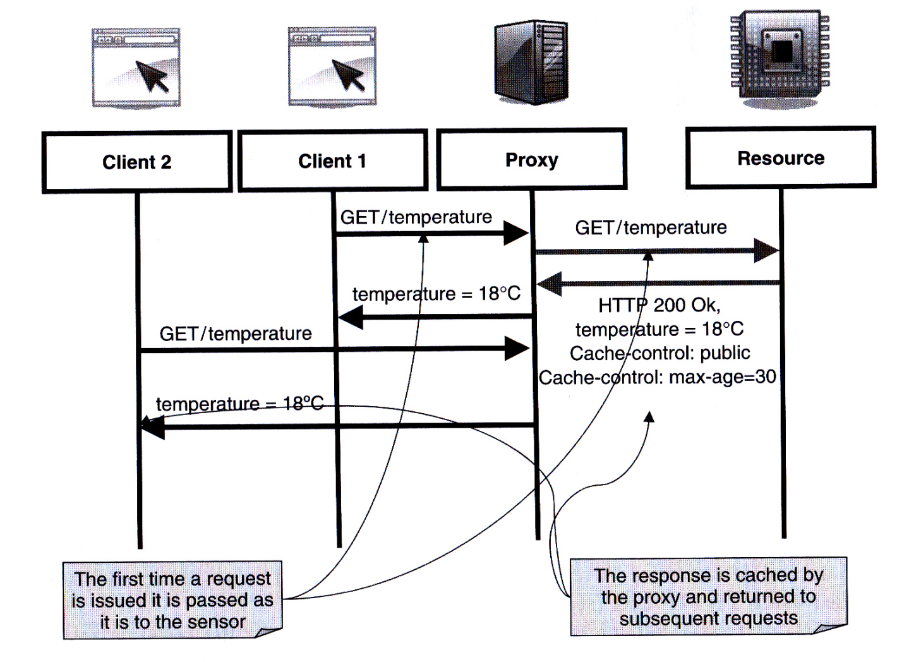
M2M REST – Use of Proxy to READ
Source: M2M Communications: A Systems Approach, Wiley, 2012
This shows that a proxy is used to cache the result of a GET of Client 1
so that the request from Client 2 can get the result form the cache in the proxy.
Notes:
M2M REST –用代理器作READ
．這張圖表明，代理器被用來暫存客戶端 1 所發GET請求的結果，所以客戶端 2 所發請求可以從代理器的暫存中得到結果。

Slide 54
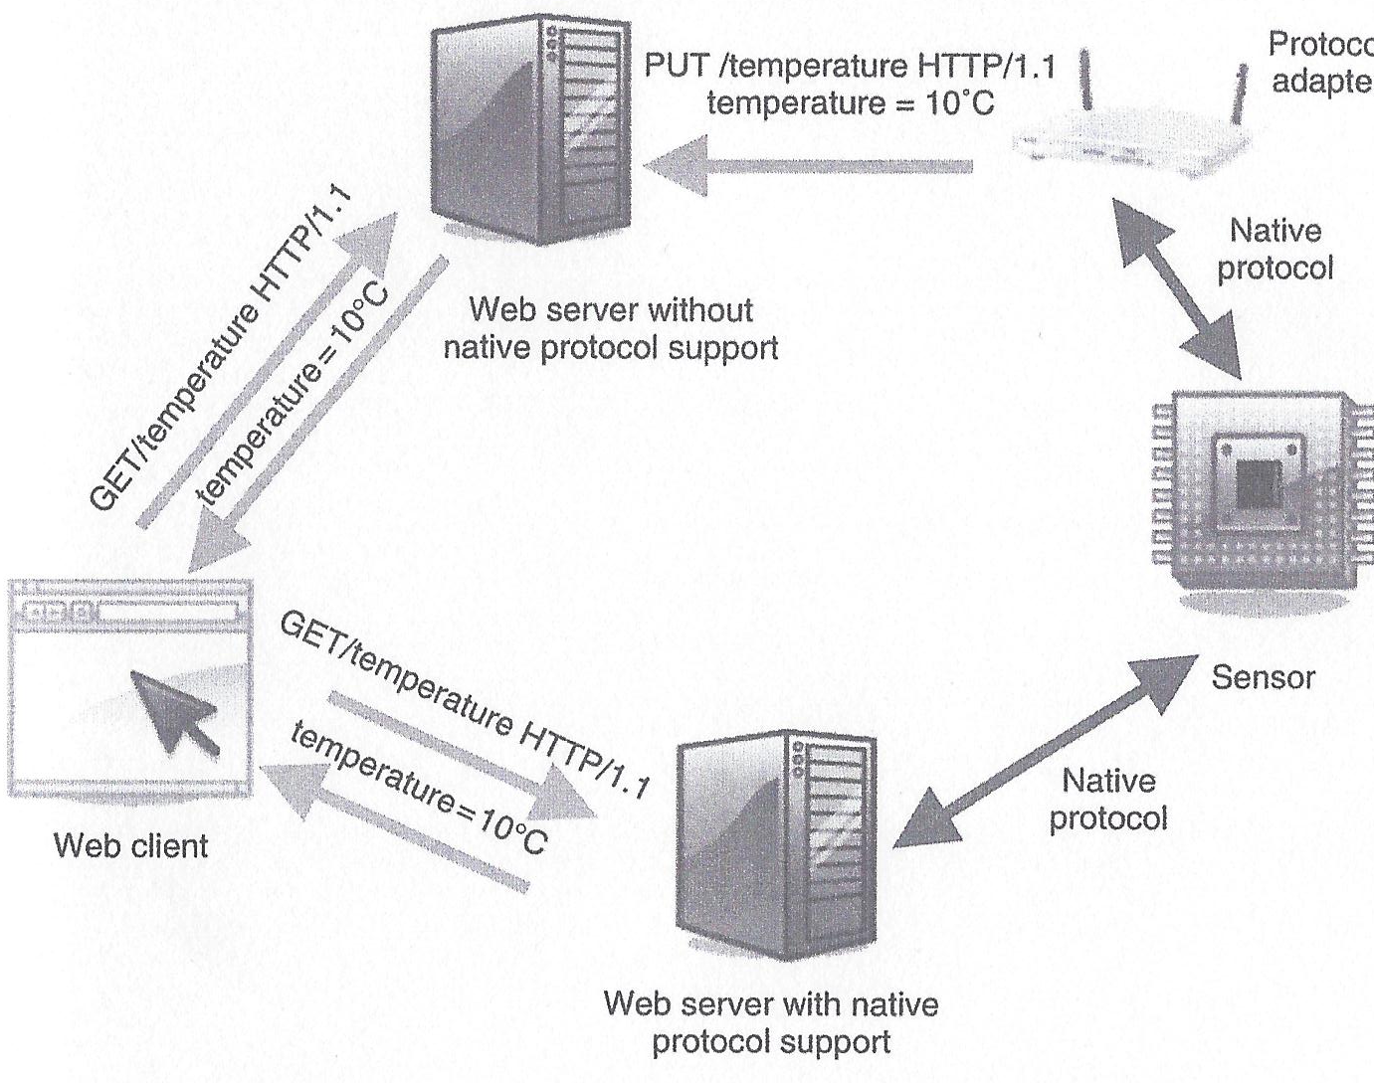
M2M REST – Read from Sensors with Native Protocols
Source: M2M Communications: A Systems Approach, Wiley, 2012
Notes:
M2M REST – 用Native協定讀取感測器

Slide 55
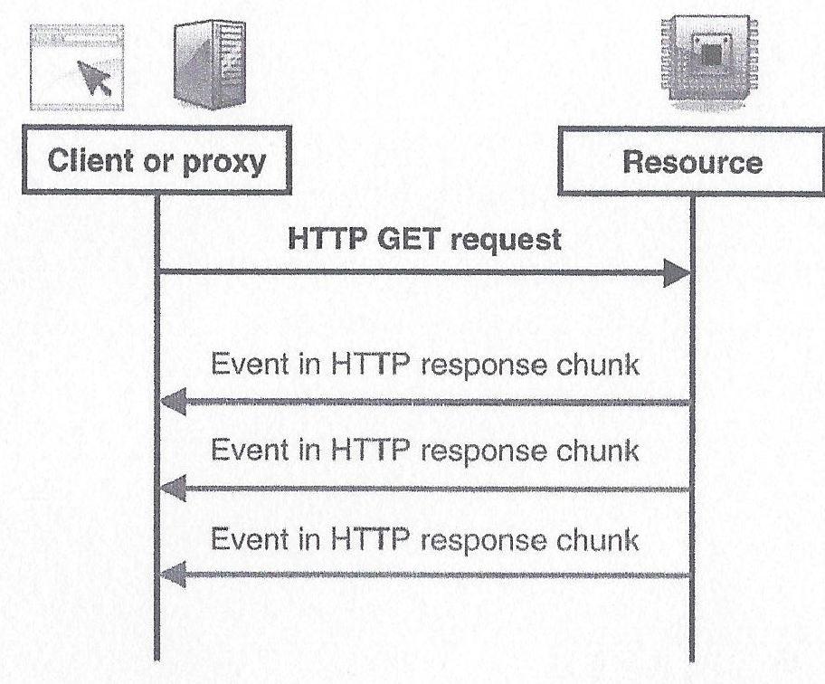
M2M REST – Get Steaming Events from Sensors via Multipart HTTP Responses
Source: M2M Communications: A Systems Approach, Wiley, 2012
HTTP “Server Push” Technique for sending streaming events
(requires support of special MIME type) from M2M resource to client or proxy
Notes:
M2M REST –透過Multipart HTTP回應從感測器取得串流事件
．用HTTP “Server Push” 技術從M2M資源傳送串流事件( 需要特別的MIME型別作支援 )到客戶端或代理器 。

Slide 56
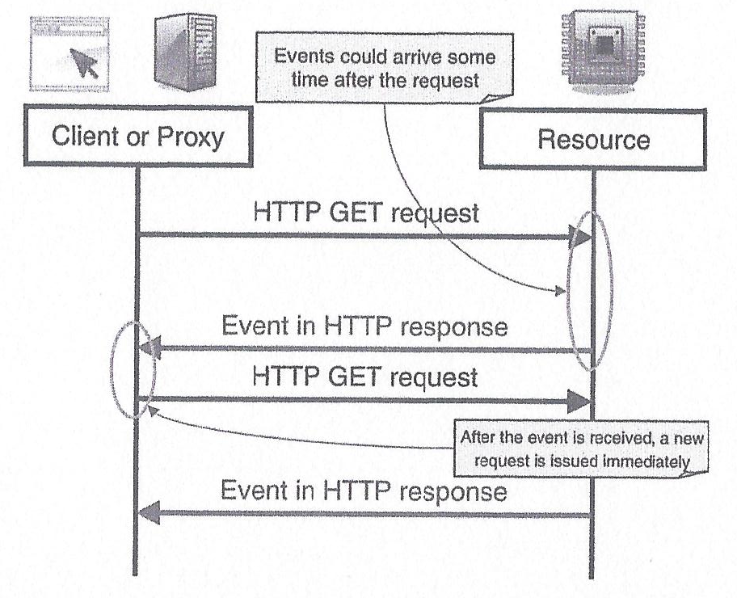
M2M REST – Get Continuous Responses from Sensors via HTTP
Source: M2M Communications: A Systems Approach, Wiley, 2012
HTTP “Long Polling” Technique for sending continuous responses
(doesn’t need support of special MIME type) from M2M resource to client or proxy
Notes:
M2M REST – 透過HTTP從感測器取得連續性回應
．用HTTP “Long Polling” 技術從M2M資源傳送連續性回應( 不需要特別的MIME型別作支援 )到客戶端或代理。

Slide 57
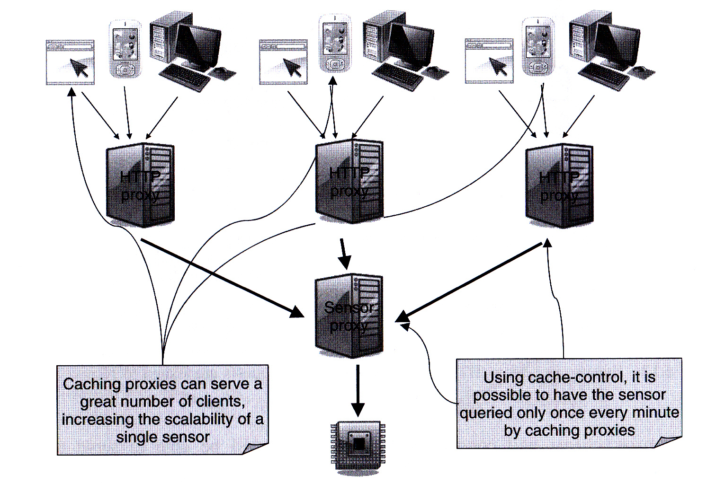
M2M REST – Use of Caching Proxies to Increase Scalability of Sensor Reading
Control of Caching using HTTP
If-Modified-Since Header(Request)
Last-Modified Header(Response)
Not Modified(Response)
Expiration Time(Response)
Source: M2M Communications: A Systems Approach, Wiley, 2012
Two layers of HTTP proxies to increase scalability of access to an M2M sensor
Notes:
M2M REST –用暫存代理器來增進感測器讀取的可擴展性
．二層的 HTTP代理器用來增進連結到M2M感測器的可擴展性
使用HTTP來作暫存控制
If-Modified-Since 信息頭（請求）
Last-Modified信息頭（響應）
不修改（響應）
截止時間（響應）

Slide 58
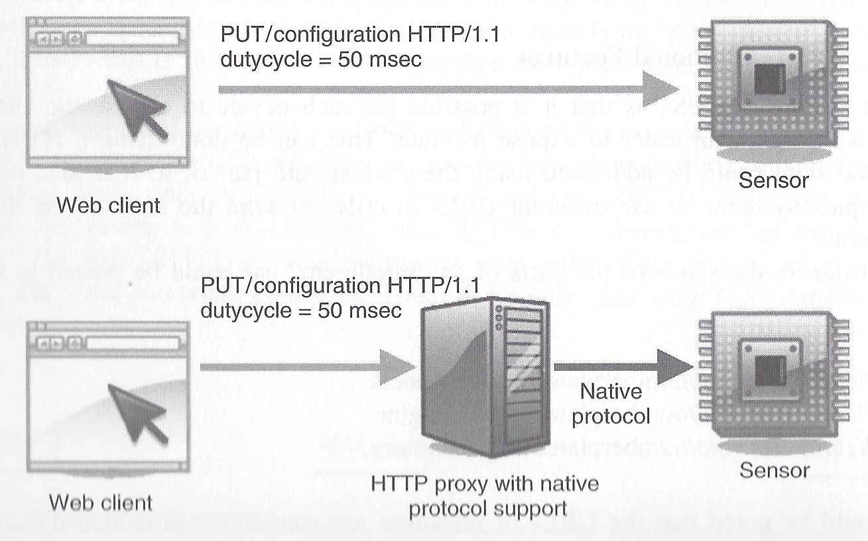
M2M REST – Configure Device via HTTP (1)
Source: M2M Communications: A Systems Approach, Wiley, 2012
Use of HTTP PUT to configure sensor devices: (1) directly or (2) via device native protocol
Notes:
M2M REST – 透過HTTP配置設備 ( 1 )
．用HTTP PUT來配置感測設備：
( 1 )直接地
( 2 )透過設備native協定

Slide 59
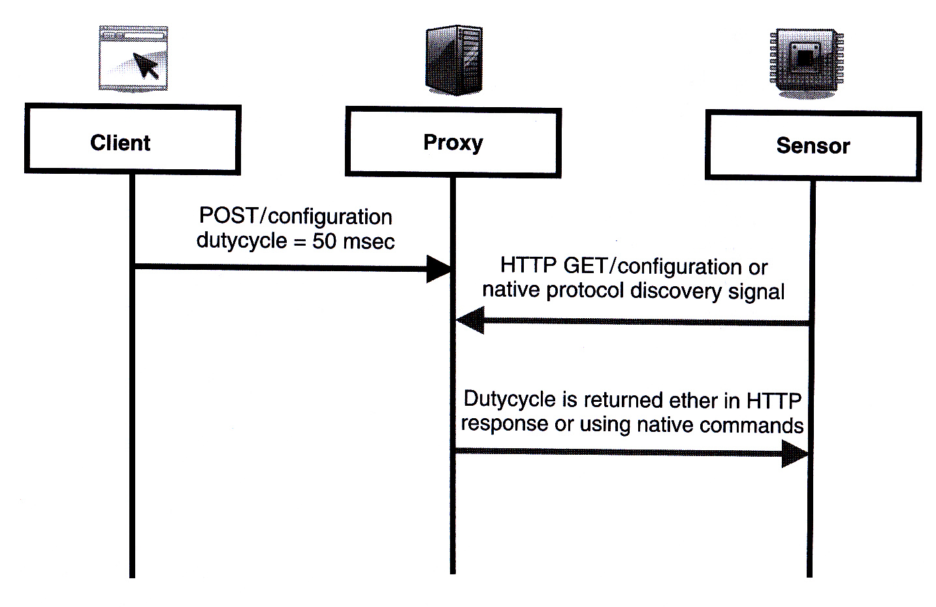
M2M REST – Configure Device via HTTP (2)
Source: M2M Communications: A Systems Approach, Wiley, 2012
Use of HTTP POST to configure sensor devices via a Proxy
Notes:
M2M REST – 透過HTTP配置設備( 2 )
．用HTTP POST 藉代理器來配置感測設備：
( 1 )直接用HTTP
( 2 )透過設備native協定

Slide 60
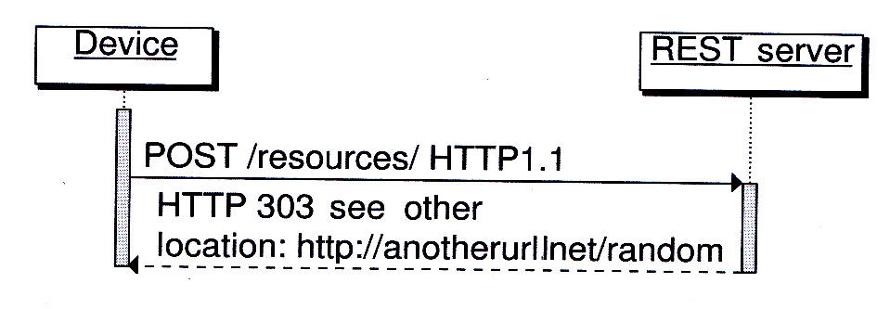
Store M2M Device States in the REST Server (1)
Source: M2M Communications: A Systems Approach, Wiley, 2012
Step 1. Create a resource representation in the REST Server
by sending a POST to the REST Server.
The REST Server returns with the URL of the newly created resource.
Notes:
在REST伺服器中存儲M2M設備狀態 ( 1 )
步驟 1：藉由送一個POST到REST伺服器，在REST伺服器中創建一個資源表示。
REST伺服器返回新創建資源的URL。

Slide 61
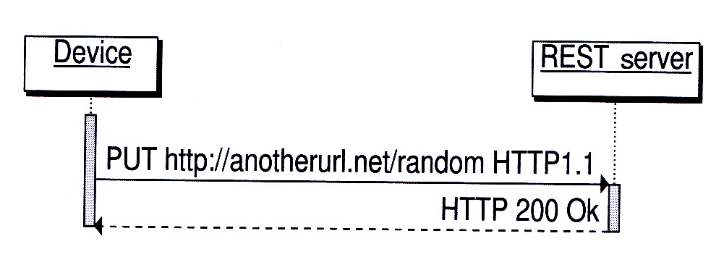
Store M2M Device States in the REST Server (2)
Source: M2M Communications: A Systems Approach, Wiley, 2012
Step 2. Device then stores its state to the newly created resource
by sending a PUT to the REST Server.
Notes:
在REST伺服器中存儲M2M設備狀態 ( 2 )
步驟 2：藉由送一個PUT到REST伺服器，設備將本身的狀態存儲到新創建資源中。

Slide 62
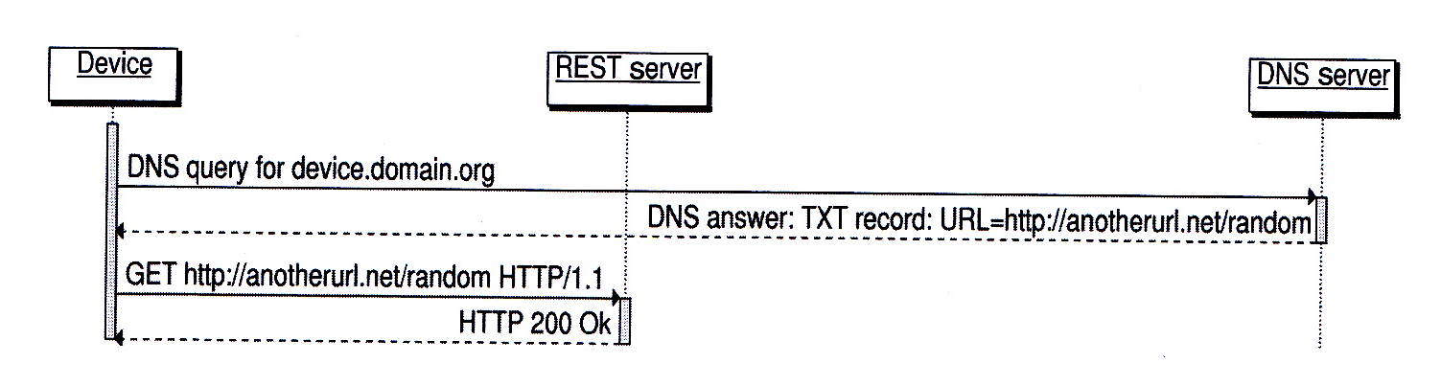
Retrieve M2M Device States in the REST Server
Source: M2M Communications: A Systems Approach, Wiley, 2012
To retrieve the state of an M2M device, the requester first needs to discover
the address of the REST server for the device from the DNS server.
It then sends a GET to retrieve the state of the device.
Notes:
在REST伺服器中得到M2M設備狀態
．為了得到M2M設備狀態，請求者首先需要從DNS伺服器中找出對應到此設備的REST伺服器位址，接著送一個GET來得到設備狀態。

Slide 63
Resource-Based M2M Communications
Notes:
基於資源的M2M通訊

Slide 64
Resource-based Information Model
All entities in the oneM2M System, such as AEs, CSEs, data, etc. are represented as resources.
A resource structure is specified as a representation of such resources. Such resources are uniquely addressable via a Uniform Resource Identifier (URI).
A given Resource is of one of the defined Resource Types.
The Resource Type determines the semantics of the information in the Resource
Notes:
基於資源的信息模型
oneM2M系統中的所有實體（如AE，CSE，資料等）都表示為資源。
資源結構被指定來表示這樣的資源,這樣的資源可以透過URI來做唯一的定址。
一個給定的資源是在定義的資源型態中的一種。
資源型態決定資源裡信息的語義。

Slide 65
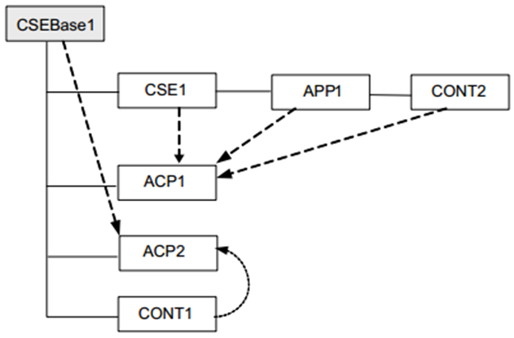
Information Modelling
Resource-based information model
Information is stored in the system as Resources
A given Resource can be identified with a Uniform Resource Identifier
A given Resource is of one of the defined Resource Types
The Resource Type determines the semantics of the information in the Resource
Resources can be Created, Read, Updated or Deleted to manipulate the information
Resources are organized in a tree-like structure and connected by links
Links either as the tree hierarchy or to another part or the tree

Slide 66
Properties of Resources
Resources can be Created, Read, Updated or Deleted to manipulate the information.
Resources are organized in a tree-like structure and connected by links.
Addressing all resources and associated attributes through unique URI.
Structured URI based on the chain of child-parent relationship
Flat URI made of a unique identifier addressable via the base root
Notes:
資源特性
可以對資源做Create, Update, Read, Delete 來操作信息。
資源被組織成一個樹狀的結構 借由鏈接連結。
通過唯一URI定址所有資源和關聯的屬性。

Slide 67
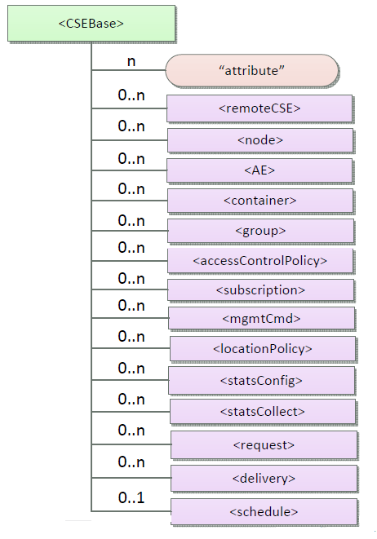
oneM2M Resource Structure (1)
Resource Type | Description
CSEBase | The structural root for all the resources that are residing on a CSE
remoteCSE | Represents a remote CSE registered on the registrar CSE identified by the CSEBase resource
node | Represents specific Node information
AE | Stores information about the AE. It is created as a result of successful registration of an AE with the registrar CSE
container | Shares data instances among entities. Used as a mediator that takes care of buffering the data to exchange "data" between AEs and/or CSEs.
group | Stores information about resources of the same type that need to be addressed as a Group
accessControlPolicy | It controls "who" is allowed to do "what" and the context in which it can be used for accessing resources
subscription | represents the subscription information related to a resource.
Notes:
oneM2M 資源結構(1)
CSEBase –所有駐留在CSE上的資源的結構根
remoteCSE-表示向CSEBase資源標識的CSE上註冊的遠程CSE
node-表示特定節點信息
AE-存儲有關AE的信息。 它是向CSE成功註冊AE的結果而創建的
container-在實體之間共享數據實例。 用作調解器，負責緩衝數據以在AE和/或CSE之間交換“數據”。
group-存儲有關需要作為群組處理的相同類型的資源的信息
accessControlPolicy-它控制“誰”被允許做“什麼”以及它可以用於訪問資源的context
Subscription-表示與資源相關的訂閱信息

Slide 68
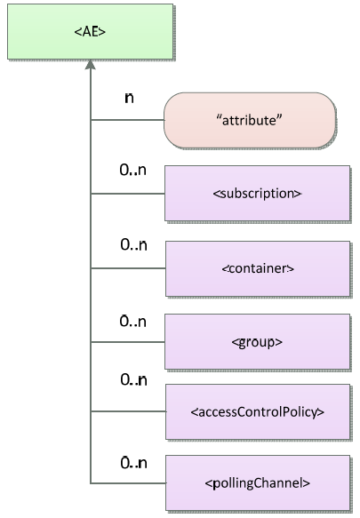
oneM2M Resource Structure (2)
Resource Type (Cont.) | Description
mgmtCmd | Management Command resource represents a method to execute management procedures required by existing management protocols.
locationPolicy | Includes information to obtain and manage geographical location. It is only referenced within a container, the contentInstances of the container provide location information
statsconfig | Stores configuration of statistics for applications
StatsCollect | Defines triggers for the IN-CSE to collect statistics for applications
request | Expresses/access context of an issued Request
delivery | Forwards requests from CSE to CSE
schedule | Contains scheduling information for delivery of messages
pollingChannel | Represent a channel that can be used for a request-unreachable entity
Details in “Table 9.6.1.1-1 Resource Types” of oneM2M-TS0001
Notes:
oneM2M 資源結構(2)
mgmtCmd-管理命令資源表示執行現有管理協議所需的管理過程的方法。
locationPolicy-包括獲取和管理地理位置的信息。 它只在容器中引用，容器的contentInstances提供位置信息
statsconfig-存儲應用程式的統計信息配置
statsCollect-定義IN-CSE為應用程式收集統計信息的觸發器
request-表達/訪問已發出請求的上下文
delivery-向CSE轉發來自CSE的請求
schedule-包含用於傳遞訊息的調度信息
pollingChannel-表示可用於請求不可到達實體的通道

Slide 69
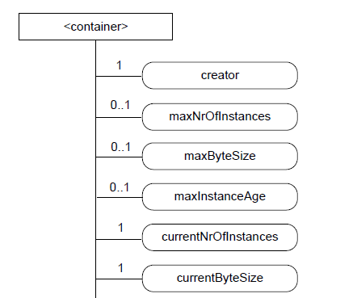
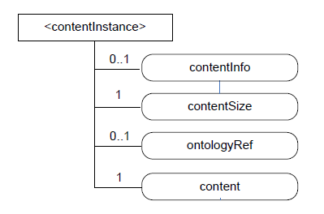
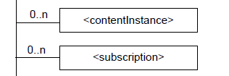
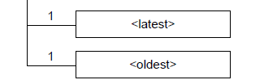
oneM2M Resource Structure (3)
Container & ContentInstance
where the actual data is stored!
Notes:
oneM2M 資源結構(3)
Container & ContentInstance :儲存實際的資料

Slide 70
Resource Types & Flows
Defined resource types
The System (nodes, CSEs, AEs…): node, CSEBase, AE, mgmtObj…
M2M Service subscriptions: m2mServiceSubscriptionProfile…
Security: accessControlPolicy…
Entity groups and memberships: group, members…
Application data: container, contentInstance…
Information dispatch and flows: subscription, delivery, request, schedule…
Location services: locationPolicy…
Service charging & accounting: statsConfig, eventConfig, statsCollect…
Defined communication schemes
Direct communication and subscriptions/notifications
Synchronous (blocking or non-blocking with regular polling) communications
Asynchronous (non-blocking, with callback) communications

Slide 71
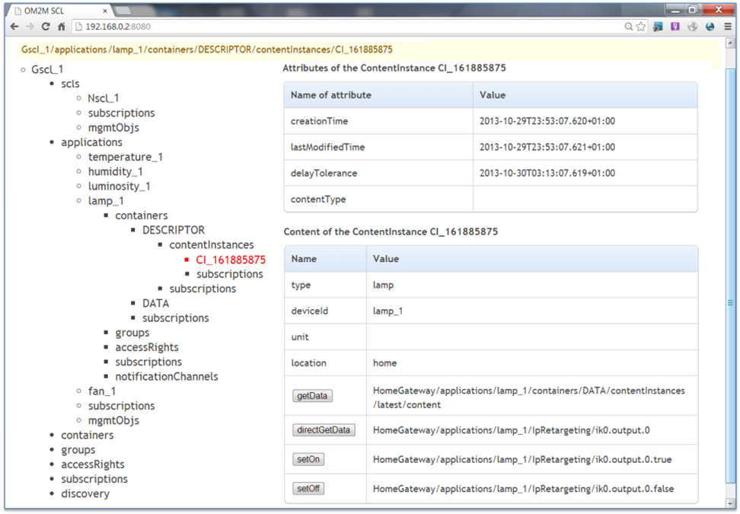

Slide 72
Resource Categories
oneM2M identifies three categories of resources:
Normal resources
include the complete set of representations of data which constitutes the base of the information to be managed.
Virtual resources
used to trigger processing and/or retrieve results, but they do not have a permanent representation in a CSE.
Announced resources
a resource at a remote CSE that is linked to the original resource that has been announced, and it maintains some of the characteristics of the original resource.
Notes:
資源分類
oneM2M識別三類資源
一般資源(Normal resources) :包含資料的表示的完整集合,而這些資料的表示是構成要被管理的信息的基礎。
虛擬資源(Virtual resources):用於觸發處理和/或取得結果,但是它們在CSE中不具有永久表示。
公告資源(Announced resources): 在遠端CSE的資源,其鏈接到已經公告的原始資源，並且其維持原始資源的一些特性。

Slide 73
Virtual Resource or Attribute
Virtual resource or a virtual attribute is used to trigger processing and/or retrieve results, but they do not have a permanent representation in a CSE, for example:
FanOutPoint virtual resource is used for addressing bulk operations to all the resources that belong to a group.
Latest/Oldest virtual resources are pointers to the actual latest and oldest Content Instance in a Container.
Notes:
虛擬的資源或屬性
虛擬的資源或是虛擬的屬性是用於觸發處理和/或取得結果,但是它們在CSE中不具有永久表示, 例如：
-FanOutPoint 虛擬資源:是用來對屬於一個組的所有資源執行批次操作。
-Latest/Oldest 虛擬資源: 指向實際上在Container裡最新和最舊的ContentInstance。

Slide 74
Resource Addressing
The address of a resource is a string that uniquely identifies the targeted resource within the scope of a request.
Requests can have 3 different scopes:
CSE-relative, the request is originated within the same CSE as the targeted resource.
SP-relative, the request is originated within the same M2M Service Provider domain as the targeted resource, but at different CSE.
Absolute, the request is originated within an M2M Service Provider domain, but the target resource resides in a different M2M Service Provider domain.
Notes:
資源定址
資源的地址是字串,用來識別請求範圍內的目標資源。
請求有三種不同的範圍:
- CSE-relative: 請求與目標在相同CSE
- SP-relative: 請求與目標是相同的M2M服務提供商,但是在不同的CSE
- Absolute: 請求與目標是在不同的M2M服務提供商

Slide 75
Resource Addressing (cont’d)
Two different methods for addressing a resource:
Hierarchical URI (structured)
Non-Hierarchical URI (non-structured)
Each addressing method can have three variants depending on the scope of the request:
 | CSE-relative | SP-relative | Absolute
Hierarchical | streetX/houseY/roomZ/temp123 | /MN-CSE-02/streetX/houseY/roomZ/temp123 | //m2m.com/MN-CSE-02/streetX/houseY/roomZ/temp123
Non-Hierarchical | temp123 | /MN-CSE-02/temp123 | //m2m.com//MN-CSE-02/tempe123
Notes:
資源定址（cont’d）
兩種不同定址方法:
Hierarchical URI(結構化的)
Non-Hierarchical URI (非結構化的)
根據請求的範圍，每種定址方法可以有三種變體

Slide 76
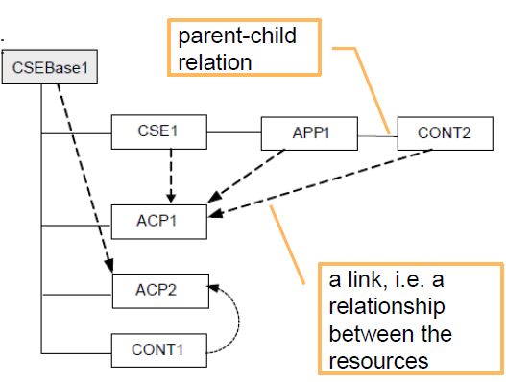
Relationship between Resources
Two types of relationships: parent-child and link
Origin Resource type | Destination Resource type | Relationship type
Any (e.g. AE, container) | Access Control Policy | Link (access Control Policy ID)
CSEBase or remoteCSE | node | Link (nodeLink)
node | CSEBase or remoteCSE | Link (hosted CSE Link or CSEBase)
a child resource of any resource type | a parent resource of any resource type | Link (parent-ID)
a parent resource of any resource type | a child resource of any resource type | Parent-Child
mgmtObj | mgmtObj | Link (mgmtLink)
Source: oneM2M TS-0001
Notes:
資源間的關係
兩種類型的關係: parent-child (父-子) 和 link(鏈接)

Slide 77
Normal Resource Types (1)
Access Control Policy
Content Instance
AE
Container
CSE Base
Delivery
Event Config
Exec Instance
Group
Location Policy
Latest (virtual)
Fan Out Point (virtual)
mgmtCmd
mgmtObj
M2m Service Subscription Profile
Node
Oldest (virtual)
Polling Channel
Polling Channel URI (virtual)
Remote CSE
Notes:
一般資源型態(1)
此頁列了一般的資源型態有那些,其中標示以下的資源型態為虛擬
Latest
Fan Out Point
Oldest
Polling Channel URI

Slide 78
Normal Resource Types (2)
Request
Schedule
Service Subscribed Node
Service Subscribed App Rule
Stats Collect
Stats Config
Subscription
Notes:
一般資源型態(2)
此頁繼續列了一般的資源型態有那些

Slide 79
Resource Type Specializations
Used by Communication Management and Delivery Handling or Device Management CSFs
ActiveCmdhPolicy
Area Network Device Info
Area Network Info
Battery
cmdhBuffer
cmdhDefaults
cmdhEcDefParamValues
cmdhDefEcValue
cmdhLimits
cmdhNetworkAccessRules
cmdhNwAccessRule
cmdhPolicy
Device Capability
Device info
Event Log
Firmware
Memory
Reboot
Software
Notes:
資源型態專業化
此頁列出的被通信管理和傳輸處理或裝置管理的CSFs使用

Slide 80
oneM2M Communication Concepts Subscribe Notify
Data is often provided in irregular intervals.
To alleviate the need for constant polling, a subscribe/notify mechanism is used.
Notifications can be twofold:
Synchronous (long polling)
Asynchronous (server capable client)
Application Entity
Subscribe
Notify
Common Service Entity
(CSE)
Notes:
oneM2M通訊概念
訂閱 通知
資料通常以不規則的間隔被提供。
為了減輕不斷輪詢的需要 ,訂閱/通知機制被使用。
通知可以是雙重:
-同步
-非同步

Slide 81
M2M End to End Communication High Level Overview
Network Application on Infrastructure Node
e.g. Visualization GUI
Infrastructure Node CSE (IN-CSE)
M2M Server
For a simple end to end example consider the following scenario:
A Device application, for example a SmartMetering Sensor is connected to a local M2M gateway.
A Network Application, e.g. a SmartMeter GUI is connected to a IN-CSE for visualizing sensor data.
Middle Node CSE (MN-CSE)
M2M Gateway
Device Application on Application Node (AN)
M2M Device e.g. Sensor
Notes:
M2M端到端通訊
高階層概述
對於簡單的端到端範例,考慮以下情形：
一個裝置應用(DA), 例如SmartMetering感測器連接到本地端M2M閘道。
一個網路應用(NA) ,例如智能儀表GUI連接到IN-CSE，用於視覺化感測器資料。

Slide 82
M2M End to End Communication High Level Overview
Network Application on Infrastructure Node
e.g. Visualization GUI
Register
Registration Phase
NA and DA register at their respective local CSEs.
The MN-CSE registers at the IN-CSE
Infrastructure Node CSE (IN-CSE)
M2M Server
Register
Middle Node CSE (MN-CSE)
M2M Gateway
Register
Device Application on Application Node (AN)
M2M Device e.g. Sensor
Notes:
M2M端到端通訊
高階層概述
註冊階段
NA 和 DA 分別向它們的本地端CSE註冊。
MN-CSE向IN-CSE註冊。

Slide 83
M2M End to End Communication High Level Overview
Network Application on Infrastructure Node
e.g. Visualization GUI
Announcement
MN-CSE announces local applications towards the IN-CSE.
Infrastructure Node CSE (IN-CSE)
M2M Server
Announce
Middle Node CSE (MN-CSE)
M2M Gateway
Device Application on Application Node (AN)
M2M Device e.g. Sensor
Notes:
M2M端到端通訊
高階層概述
公告
MN-CSE 向IN-CSE公告本地端的應用。

Slide 84
M2M End to End Communication High Level Overview
Network Application on Infrastructure Node
e.g. Visualization GUI
Retrieve / Subscribe
The NA retrieves information on existing applications -> receives information about the sensor DA
If neccessary, the request is retargeted by the IN-CSE to the MN-CSE
Subsequently, the NA subscribes to the DA‘s data in order to be notified when new data arrives.
Infrastructure Node CSE (IN-CSE)
M2M Server
Retarget
Middle Node CSE (MN-CSE)
M2M Gateway
Source: Tutorial from FOKUS
Device Application on Application Node (AN)
M2M Device e.g. Sensor
Notes:
M2M端到端通訊
高階層概述
NA取得現有應用程式的信息 ->取得關於感測器DA的信息。
如果有需要 要求可以被IN-CSE重定目標到MN-CSE。
以後, 為了當新的資料到來時能夠被通知,NA訂閱DA的資料。

Slide 85
M2M End to End Communication High Level Overview
Network Application on Infrastructure Node
e.g. Visualization GUI
Notify
Periodically, the sensor DA pushes metering data to the local gateway.
This is done by creating a „contentInstance“
The incoming data is announced towards the IN-CSE.
The NA is notified about the incoming data.
Infrastructure Node CSE (IN-CSE)
M2M Server
Announce
Middle Node CSE (MN-CSE)
M2M Gateway
Create
Device Application on Application Node (AN)
M2M Device e.g. Sensor
Notes:
M2M端到端通訊
高階層概述
感測器DA周期性的傳送偵測到的資料到本地端閘道。
透過創造contentInstance來完成。
這些收到的資料也被公告給IN-CSE。
NA被通知關於這些收到的資料。

Slide 86
M2M Service Subscription (1)
An M2M Service is the marketable service offered to M2M users, e.g. device management, data exchange, etc.
M2M Service Subscription establishes a link between
One or more AEs;
One or more M2M Nodes,
One or more roles associated with an M2M Service Subscription as well as subscriber defined groups (used for access control policies).
In each M2M Service, one or multiple M2M Service role(s) shall be defined by the M2M Service Provider.
Notes:
M2M服務訂閱(1)
It shall be possible for an M2M Service Providers to define their own services and roles
M2M服務提供商應該可以定義自己的服務和角色
M2M服務是向M2M用戶提供的可銷售服務，例如， 設備管理，數據交換等
M2M服務訂閱建立之間的鏈接
一個或多個AE
一個或多個M2M Node
與M2M服務訂閱相關聯的一個或多個角色以及訂戶定義的群組（用於access control policies）。
在每個M2M服務中，一個或多個M2M服務角色將由M2M服務提供商定義。

Slide 87
M2M Service Subscription (2)
An M2M Service subscription role is defined as a set of privileges pertaining to a resource types which are associated with M2M Service.
The M2M Subscriber subscribes as one or multiple roles within the M2M Services, depending upon which role(s) the M2M Subscribers are interested in.
An M2M Service Subscription shall be used for the following purposes:
Serve as a basis for authorization for resource operations.
Serve as the basis for charging.
Identify which Nodes are part of this M2M Service Subscription.
Notes:
M2M服務訂閱(2)
M2M服務訂閱角色被定義為屬於與M2M服務相關聯的資源類型的一組特權
M2M訂戶作為M2M服務內的一個或多個角色來訂閱，這取決於M2M訂戶感興趣的角色。
M2M服務訂閱將用於以下目的：
作為資源操作的基礎
作為收費的基礎
標識哪些Nodes是此M2M服務訂閱的一部分

Slide 88
General Communication Flow
The general flow is based on the use of Request and Response messages.
The message applies to communications such as:
between an AE and a CSE (Mca reference point); and
among CSEs (Mcc reference point).
Such communications can be initiated either by the AEs or by the CSEs depending upon the operation in the Request message.
Notes:
一般通訊流程
一般流程基於請求和響應消息的使用。
消息適用於:
AE和CSE之間的通訊
- CSEs之間
這種通訊可以由AE或由CSE根據請求消息中的操作來發起。

Slide 89
Request
The Request from an Originator to a Receiver includes the following parameters:
ri: Request Identifier.
to: URI of the target resource for the operation.
fr: Identifier representing the Originator.
cn: resource content to be transferred.
role: optional, required when role based access control is applied (associated text and procedure TBD).
op: operation to be executed: Create (C), Retrieve (R), Update (U), Delete (D), Notify (N)
Notes:
請求
從發起者到接收者的請求包括以下參數
ri：請求識別碼
to：操作的目標資源的URI
fr：表示發起者的識別
cn：要傳輸的資源內容
role：選擇性的，在應用基於角色的訪問控制時需要（關聯文本和過程TBD）
op：要執行的操作：創建（C），檢索（R），更新（U），刪除（D），通知（N）

Slide 90
Types of Requests
Four Classic REST Operations:
1. CREATE: Create child resources.
2. RETRIEVE: Read the content of the resource.
3. UPDATE: Write the content of the resource.
4. DELETE: Delete the resource.
Two Extended Operations:
1.NOTIFY: indicate a change of a resource for a subscription. Variant of RETRIEVE/UPDATE.
2.EXECUTE: for executing a management command/task which is represented by a resource, corresponding to an UPDATE method without payload data.
Notes:
請求的類型
四種經典REST操作：
1. CREATE：創建子資源。
2. RETRIEVE：讀取資源的內容。
3. UPDATE ：寫入資源的內容。
4. DELETE：刪除資源。
兩個擴展操作：
1.NOTIFY：指示訂閱的資源的更改。 RETRIEVE / UPDATE的變體。
2.EXECUTE：用於執行由對應於沒有有效載荷資料的UPDATE方法的資源表示的管理命令/任務。

Slide 91
Response
The Response from a Receiver to the Originator includes the following parameters:
rs: response code: This parameter indicates whether the operation was successful, unsuccessful or is an acknowledgement
ri: Request Identifier. The ri in the Response shall match the ri in the corresponding Request.
cn: (conditional) resource content.
Notes:
響應
從接收者到發起者的響應包括以下參數：
rs：響應代碼：此參數指示操作是成功，不成功還是確認
ri：請求識別碼。 響應中的ri應匹配相應請求中的ri。
cn：（有條件的）資源內容。

Slide 92
Primitive Mapping
Primitives are service layer messages transmitted over the Mca and Mcc reference points
Primitives are data structures that a specific procedure requests or answers in both originator and receiver entities.
A primitive shall consist of:
control part
optional content part: user data
Designed for Scalability, Extensibility and Efficiency
Notes:
Primitive 映射
Primitives是通過Mca和Mcc參考點傳輸的服務層消息
Primitives是特定過程在發起者和接收者實體中請求或應答的資料結構。
一個Primitive應包含:
控制部分
選擇性內容部分:使用者資料
為可擴展性，可延伸性和效率而設計

Slide 93
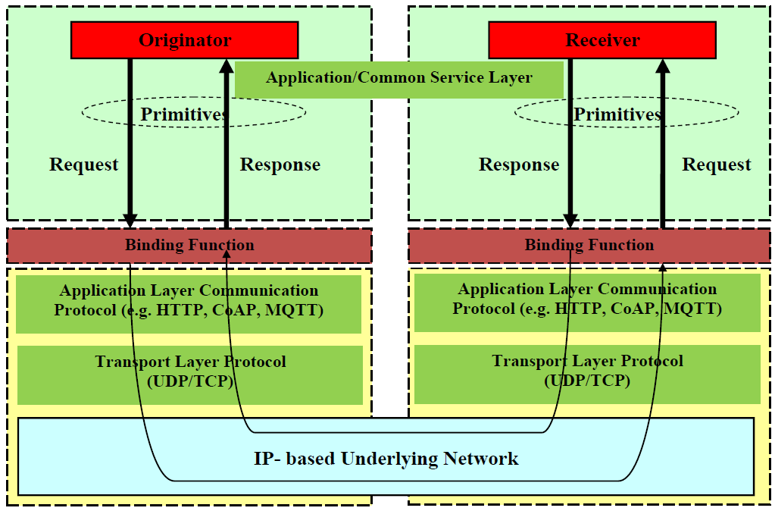
Primitive Mapping
Source: oneM2M TS-0004
Notes:
Primitive 映射
發起者傳送請求給接收者依序經過
1. Application/Common Service Layer 應用/通用服務層
2. Binding function 綁定功能
3. Application Layer Communication Protocol 應用層通信協議
4. Transport Layer Protocol 傳輸層協議
5. IP-based Underlying NetWork 基於IP的底層網絡
6. Transport Layer Protocol 傳輸層協議
7. Application Layer Communication Protocol 應用層通信協議
8. Binding function 綁定功能
9. Application/Common Service Layer 應用/通用服務層
接收者以同樣方式傳送響應給對應的發起者

Slide 94
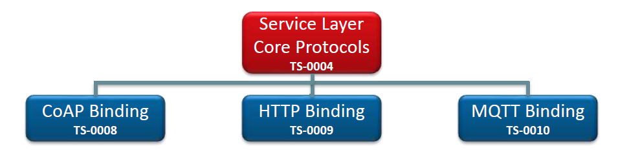
Protocol Binding
Notes:
協議綁定
Service Layer Core Protocols服務層核心協議
-CoAP 綁定
-HTTP 綁定
-MQTT 綁定

Slide 95
<xxx Resource> Primitives
xxxCreateRequest
xxxCreateResponse
xxxRetrieveRequest
xxxRetrieveResponse
xxxUpdateRequest
xxxUpdateResponse
xxxDeleteRequest
xxxDeleteResponse
xxxNotifyRequest
xxxNotifyResponse
Notes:
<xxx 資源> Primitives
此頁舉例列出 Primitive 類型

Slide 96
HTTP Binding for Primitives
Source: TS-0009-HTTP_Protocol_Binding
Notes:
Primitives的 HTTP 綁定
Primitive 類型對應 HTTP方法
xxxRetrieveRequest: GET或對POST的響應（對通信通道的長輪詢）
xxxUpdateRequest: PUT或對POST的響應（對通信信道的長輪詢）
xxxCreateRequest: POST或對POST的響應（對通信信道的長輪詢）
xxxDeleteRequest :DELETE或對POST的響應（對通信信道的長輪詢）
xxxExecRequest:POST（無主體）或對POST的響應（對通信通道的長輪詢）
xxxNotifyRequest::POST（異步通知）或響應POST（對通知信道的長輪詢）或對POST的響應（對通信信道的長輪詢）

Slide 97
Concluding Remarks (1)
In this section, we first give an overview of oneM2M Common Service Functions (CSFs) framework.
We go over each of 12 M2M CSFs.
Next, a detailed discussion on REST architectural style is given including topics on REST constraints, REST resources, REST interfaces and REST basic operations.
Then, REST architectural style specific to M2M is elaborated.
Notes:
結語 ( 1 )
．在本章，一開始我們先概述oneM2M 通用服務功能 (CSFs) 框架。
．介紹了oneM2M定義的十二種M2M通用服務功能。
．下一步，進一步論述REST架構風格的細節，包含以下主題：REST限制、REST資源、REST介面和REST基本操作。
．接著，詳述M2M的REST架構風格規範。

Slide 98
Concluding Remarks (2)
Lastly, the architectural ideas of resource-based M2M communications are explained. Under this architecture, M2M resources are represented as a data model of tree structure.
We explain this tree structure and the general communication flow used to manipulate this resource tree.
Finally, protocol binding that maps interface primitives to protocol messages is explained.
Notes:
結語 ( 2 )
．最後，闡明基於資源的M2M通訊其架構概念。在此架構下，M2M資源被表示成具有樹狀結構的資料模組。
．我們解釋了用來操作資源樹的樹狀結構以及一般通訊流程。
．最後，也解釋了介面primitives 映射到協議消息之間的協議綁定。

Slide 99
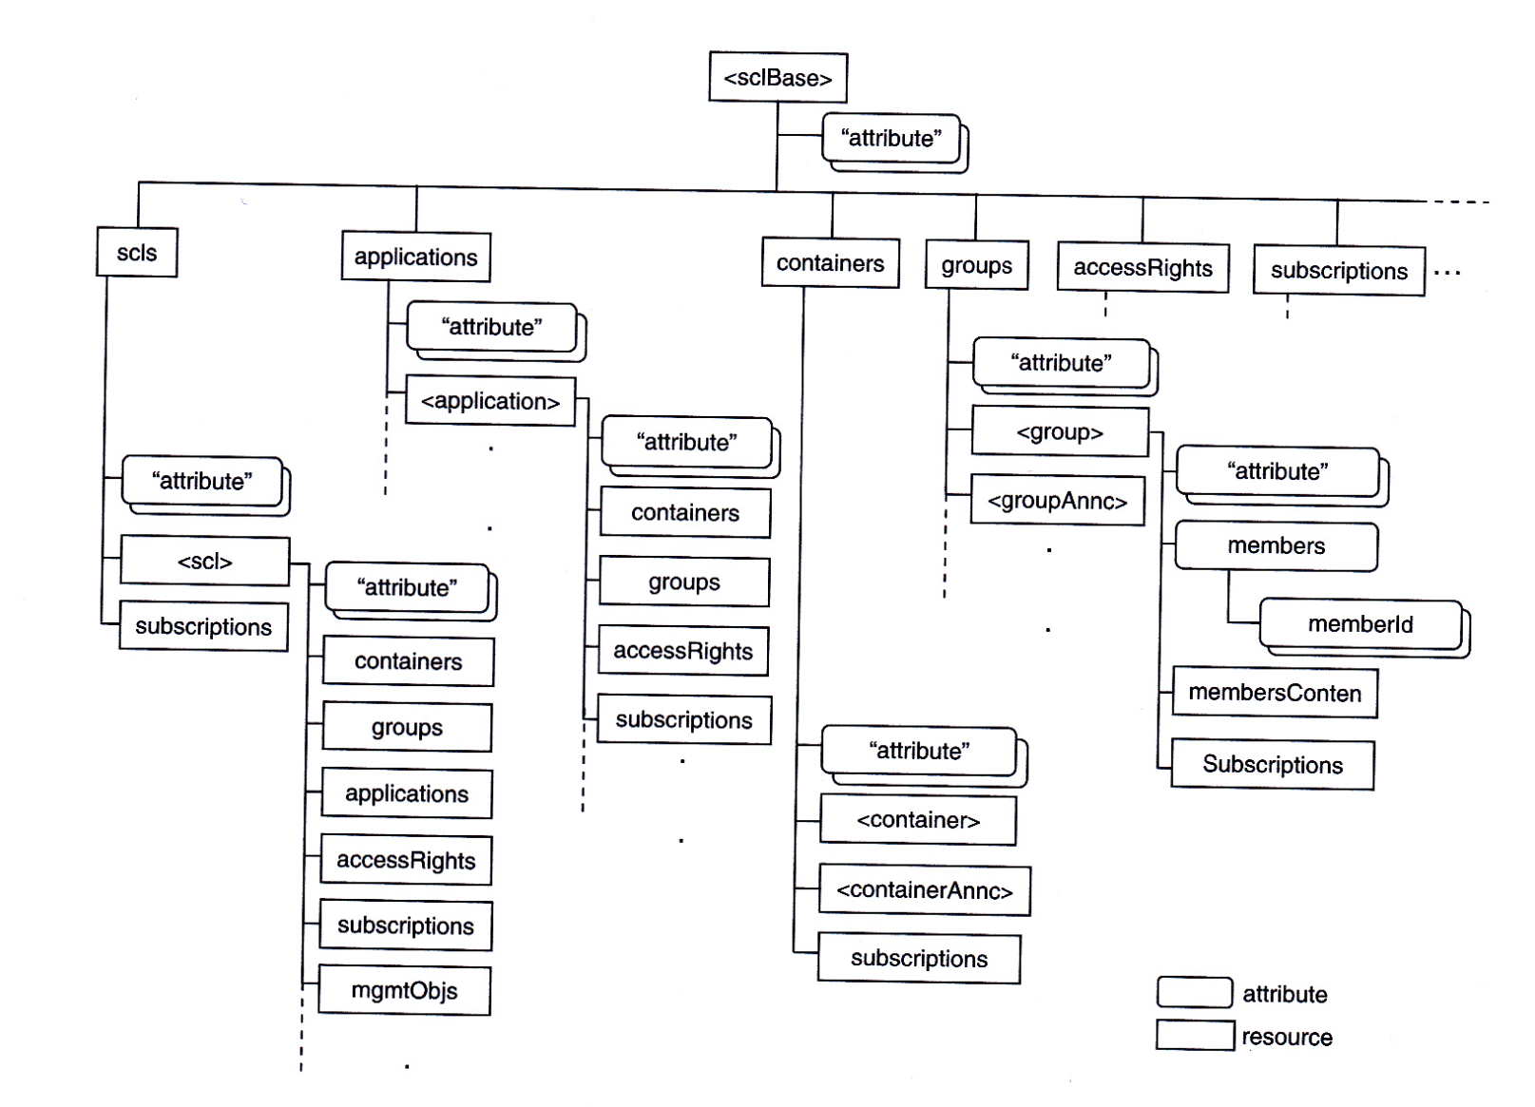
ETSI TC M2M Data Model Resource Tree
Source: M2M Communications: A Systems Approach, Wiley, 2012

Slide 100
Square vs. Rounded Boxes (Resource vs. Attributes)
resource
attribute
Source: M2M Communications: A Systems Approach, Wiley, 2012

Slide 101
<resourceName> vs. resourceName (User-defined Name vs. Pre-defined Name)
<…>
User-defined Name
applications:
Pre-defined Name
Source: M2M Communications: A Systems Approach, Wiley, 2012

Slide 102
Resources vs. Resource (Collection Resources or Not)
collection resources are always plural
Source: M2M Communications: A Systems Approach, Wiley, 2012

Slide 103
Resource Types in the Tree (1)
sclBase resource: describes the hosting SCL. Root of all other resources on the SCL.
scl resources: Storage of information for data exchange between NSCL and DSCL/GSCL.
M2M SCLs managed on other entities
stores information related to M2M SCLs residing on other M2M.
It enables SCLs interactions using retargeting operations

Slide 104
Resource Types in the Tree (2)
application resources: Storage of information about applications.
Stores information about the application after a successful registration on the hosting SCL.
container resource: Generic resources used for data exchange between applications and SCLs
acts as a mediator for data buffering to enable data exchange between applications and SCLs

Slide 105
Resource Types in the Tree (3)
accessRight resource: Storage of permission to govern which entity to access what information.
manages permissions to protect the access to the resource tree structure.
group resource: Storage of information that represents a group of resources.
enhances resources tree operations and simplifying the interactions on the API interfaces by adding the grouping feature.

Slide 106
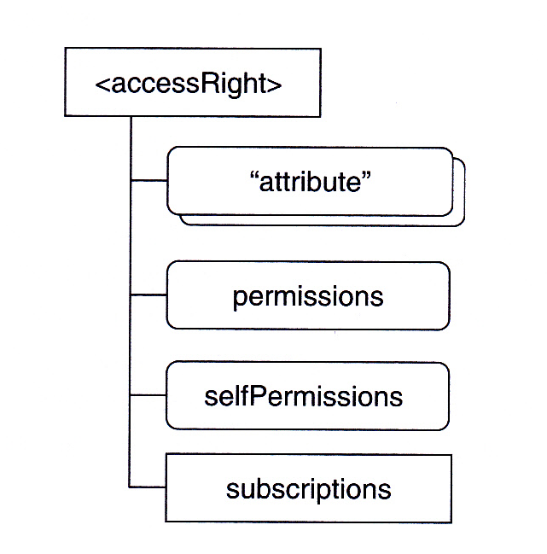
Details of AccessRight Resource
Source: ETSI TC M2M TS102.690
Permissions: entities and their rights to access the linked resource
selfPermissions: entities and their rights to update accessRight
subscriptions : entities to be notified when changes occur on accessRight

Slide 107
Resource Types in the Tree (4)
subscription resource: Keep track of status of active subscriptions to its parent resource.
It allow subscribers to receive asynchronous notification when an event happens such as the reception of new sensor event or the creation, update, or delete of a resource.
collection resource: Grouping of multiple resources with certain commonalities.
It is used at different places such as scls, applications, or containers.

Slide 108
Examples of Collection Resource
Collection Resource “scls”
Collection Resource “applications”
Collection Resource “accessRights”
Collection Resource “groups”
Collection Resource “containers”

Slide 109
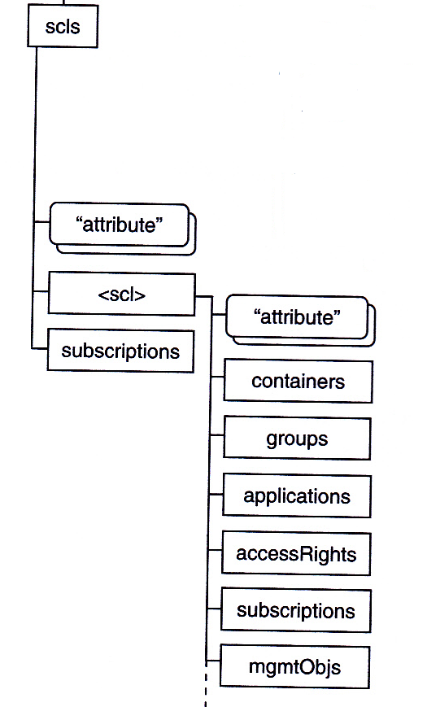
Collection Resource “scls”
For each GSCL/DSCL registering with NSCL,an
<scl> child is created on NSCL to keep track of
SCLs on devices and gateways.
Subscriptions under scls are a collection recording
all subscriptions to the resource scls.
<scl> contains
Containers
Groups
Applications
AccessRights
Subscriptions
mgmtObjs

Slide 110
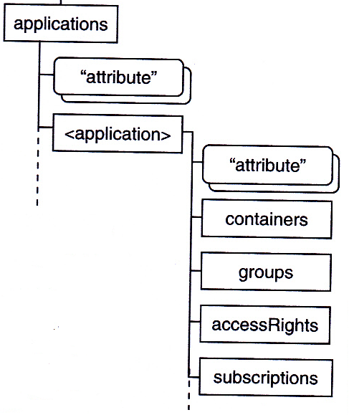
Collection Resource “applications”
Each application in “applications” collection contains
Containers
Groups
AccessRights
Subscriptions
….
Note data exchange between DSCL/GSCL and NSCL can be done via “containers” in “application” or via “containers” in “scl”. An application can use one or the other depending on business logic or data lifetime.

Slide 111
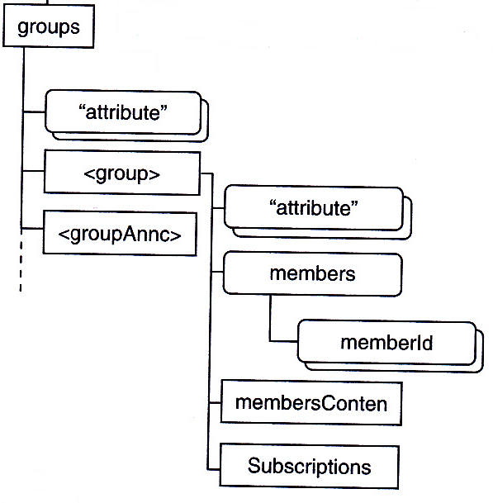
Collection Resource “groups”
Each “group” in “groups” collection contains
attributes
members
membersConten
subscriptions
….
“groupAnnc announces …

Slide 112
Resource Types in the Tree (5)
announced resource: a resource with only a partial set of attributes (such as a searchString and a link (URI) to the original resource), used in a remote SCL to allow discovery of its corresponding resource with full attributes
discovery resource acts as a search engine for resources. It enables to retrieve the set of resources URIs matching a specific filter criteria and constraints.

Slide 113
Interface Procedures
Initialization Procedures
SCLs Discovery
SCLs Registration
Application Registration
Management Procedures
access-rights management
container management
group management
resource discovery
collection management
subscription management
Resource announce/de-announce

Slide 114
Initialization Procedures
SCLs Discovery: procedures to allow a DSCL or GSCL to discover an NSCL so as to perform registration. These procedures are yet to be defined by ETSI M2M TC. Without discover procedures, a DSCL or GSCL needs to be configured in advance for its corresponding NSCL.
SCLs Registration: procedures for a GSCL or DSCL to register with the NSCL.
Application Registration: procedures for an application (NA, DA or GA) to register with its local SCL. An application cannot exchange data via SCLs with other applications without registration.

Slide 115
Management Procedure (1)
access-rights management: used to manipulate accessRights.
container management: used for data exchange between applications.
group management: used to manipulate groups of resources.
resource discovery: used to discover of resources stored or announced on a specific SCL based on filter criteria.

Slide 116
Management Procedure (2)
collection management: used to manage collection resources.
subscription management: used by an application or SCL to subscribe to certain notification criteria.
Resource announce/de-announce: used by an SCL to announce resources to a remote SCL.

Slide 117
Smart Meter Example Walkthru
Problem Description:
How can a smart meter be connected to the M2M network and how can an M2M Network Application (NA) retrieve the data from the smart meter?
Nine steps are described below.

Slide 118
Step 1. Network Bootstrap and Registration of Smart Meter
This step is access network dependent.
The goal is to configure the smart meter with all the necessary parameters (e.g. IP address, DNS, gateway etc.) to allow it to connect and register to a network.
Once bootstrapped with the network, the smart meter can proceed to service bootstrap.

Slide 119
Step 2. Service Bootstrap of Smart Meter
In this step, the smart meter will be provisioned with M2M service credentials (e.g. identities, security key etc.) in order to register (See Step 7) and connect with the M2M service layer. (See Step 8)
Once bootstrapped, DA is created for the smart meter but not yet registered with the M2M service layer.

Slide 120
Step 3. Registration of Network Application to NSCL
Network Application (NA) also needs to register to its local NSCL.
As a result, NSCL will establish NA in its resource tree and store NA information under collection resources “applications”.

Slide 121
Resource Trees on both DSCL and NSCL after Step 3
DA: meterData
NA: meterApplication1
dIa
mIa
Resource Tree on DSCL
Resource Tree on NSCL
mId
Domain Name of Utility Company:
utility1.com
<sclBase>: <protocol>://meter12345.utility1.com
<sclBase>:<protocol>://smartmetering.utility1.com
applications
meterApplication1

Slide 122
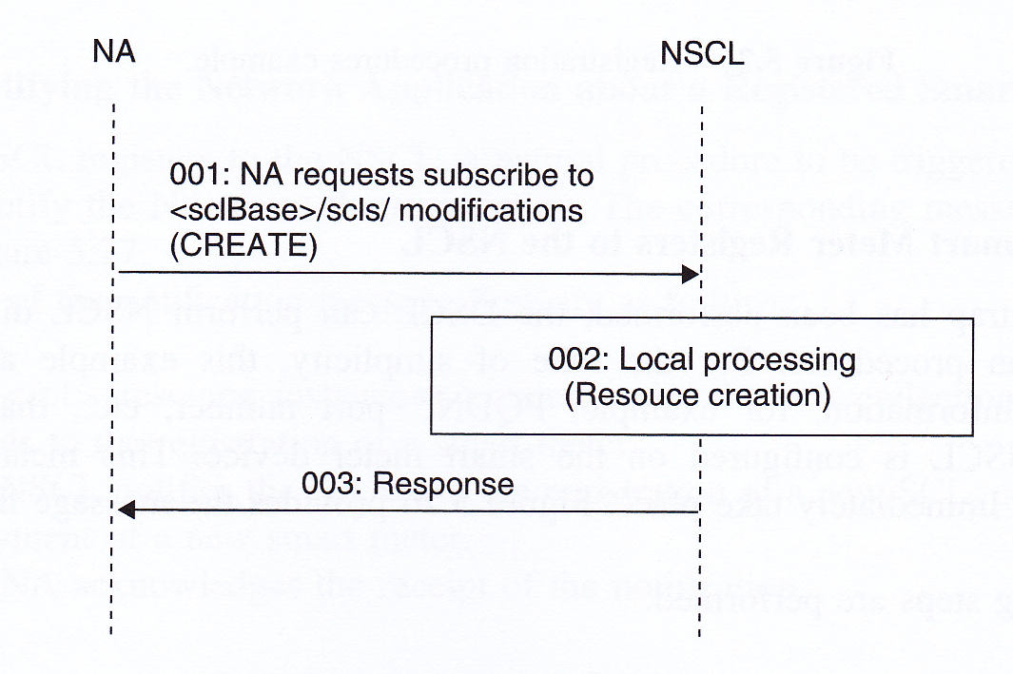
Step 4. NA Subscribes to NSCL for Smart Meter Registration
Source: M2M Communications: A Systems Approach, Wiley, 2012
The NA wants to be notified of any registered smart meter.
The NA thus subscribes to the NSCL to get notification whenever DSCLs
register under the “scls” resources.
This subscription is done by creating a “newMeters” resource under
“subscriptions”.

Slide 123
Resource Tree on NSCL after Step 4
DA: meterData
NA: meterApplication1
dIa
mIa
Resource Tree on DSCL
Resource Tree on NSCL
mId
Domain Name of Utility Company:
utility1.com
<sclBase>:<protocol>://smartmetering.utility1.com
applications
meterApplication1
scls
subscriptions
newMeters

Slide 124
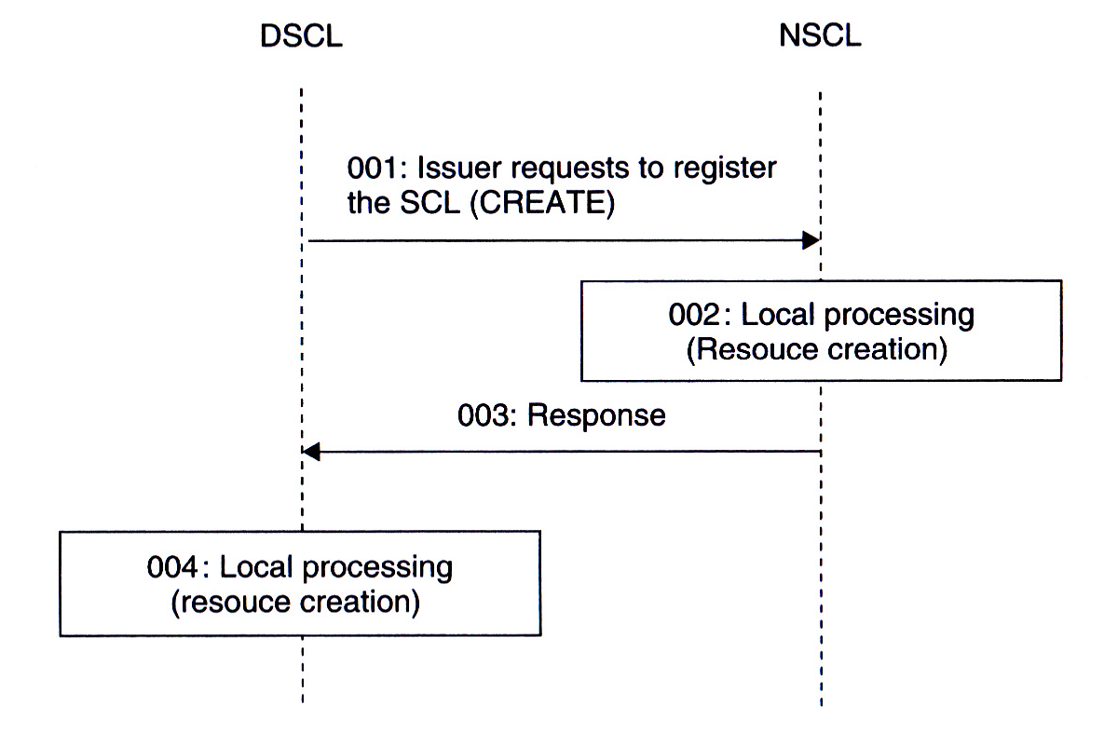
Step 5. DSCL Registers to NSCL
Source: M2M Communications: A Systems Approach, Wiley, 2012
Once the smart meter is bootstrapped, the DSCL can perform NSCL discovery
and register with NSCL.
As NSCL discovery procedures are yet to be defined, NSCL information (e.g.
FQDN, port number etc.) can be pre-configured in DSCL for this step.
DSCL requests to register with NSCL by creating an “scl” under “scls” called “meter1235”.
DSCL also creates a resource representing NSCL locally.

Slide 125
Resource Trees on both DSCL and NSCL after Step 5 (1)
DA: meterData
NA: meterApplication1
dIa
mIa
Resource Tree on DSCL
Resource Tree on NSCL
mId
<sclBase>:<protocol>://smartmetering.utility1.com
applications
meterApplication1
scls
meter12345
subscriptions
newMeters

Slide 126
Resource Trees on both DSCL and NSCL after Step 5 (2)
DA: meterData
NA: meterApplication1
dIa
mIa
Resource Tree on DSCL
Resource Tree on NSCL
mId
<sclBase>: <protocol>://meter12345.utility1.com
scls
smartMetering
The DSCL creates a resource representing the NSCL

Slide 127
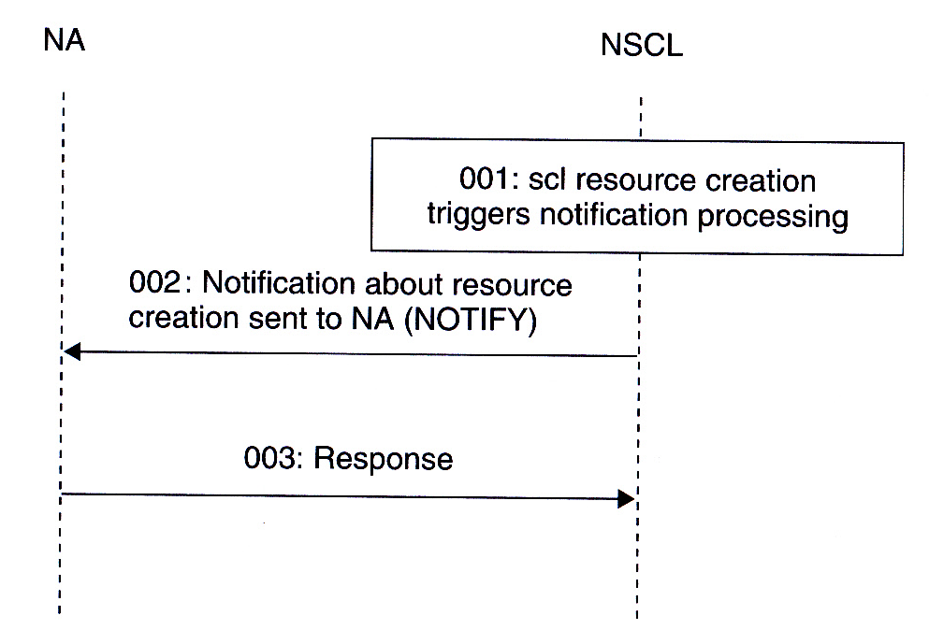
Step 6. NSCL Notifies NA about DA Registration
Source: M2M Communications: A Systems Approach, Wiley, 2012
At this moment, the NSCL will be triggered to notify the NA as the NA has subscribed to get notification whenever DSCLs register under the “scls” resources.

Slide 128
Step 7. DA Registers to DSCL
Next, DA will register locally to the DSCL using dIa interface.
Once registered, DA will be able to manipulate it local SCL and remote SCL in accordance with the accessRights.
No need for the DA to register to the NSCL as the DSCL has registered to the NSCL.

Slide 129
Resource Tree on DSCL after Step 7
DA: meterData
NA: meterApplication1
dIa
mIa
Resource Tree on DSCL
Resource Tree on NSCL
mId
<sclBase>: <protocol>://meter12345.utility1.com
applications
meterData
scls
smartMetering

Slide 130
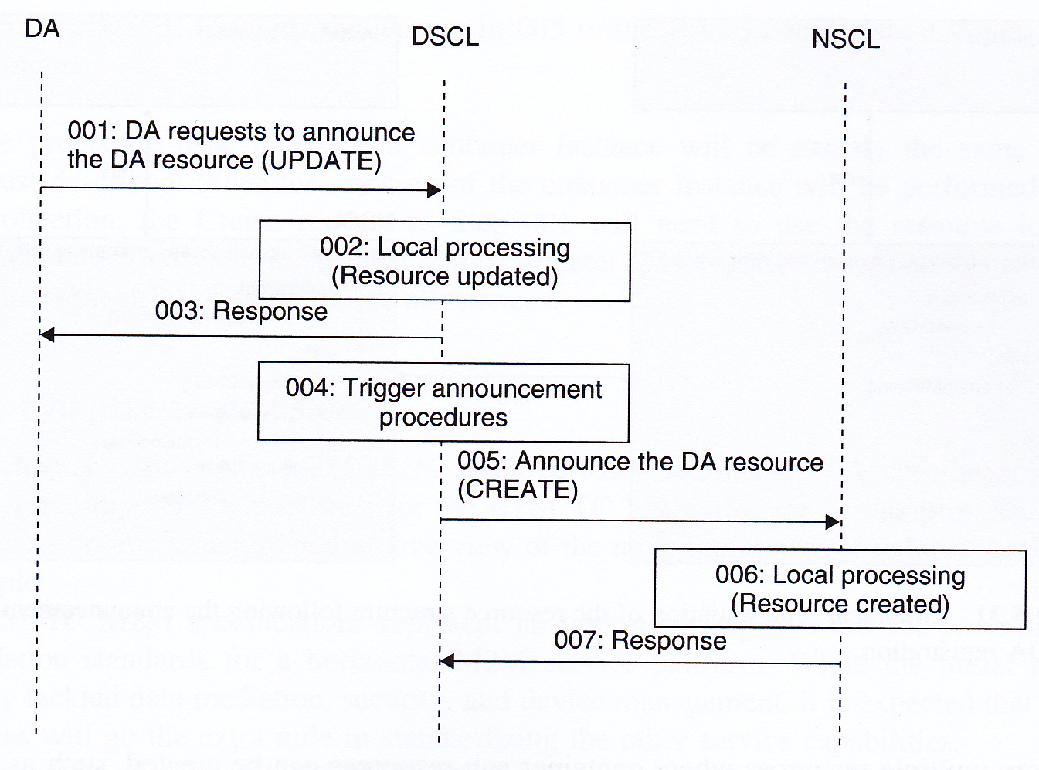
Step 8. DSCL Announces Registered DA to NSCL
Source: M2M Communications: A Systems Approach, Wiley, 2012

Slide 131
Resource Tree on NSCL after Step 8
DA: meterData
NA: meterApplication1
dIa
mIa
Resource Tree on DSCL
Resource Tree on NSCL
mId
<sclBase>:<protocol>://smartmetering.utility1.com
applications
meterApplication1
scls
meter12345
applications
meterData
subscriptions
newMeters
<applicationAnnc> resource type

Slide 132
Step 9. DA Reports Meter Data to NSCL (1)
ETSI TS02.690 specifications allow data exchange via the container collection resource under <sclBase>, <scl> or <application>.
Source: M2M Communications: A Systems Approach, Wiley, 2012

Slide 133
Step 9. DA Reports Meter Data to NSCL (2)
Two options:
Via a container collection resource under the DSCL DA application resource
<protocol>://meter12345.utility1.com/applications/meterData/
containers/meterDataSamples
Or via the container collection resource under the NSCL DA announced resource
<protocol>://smartmetering.utility1.com/scls/meter12345/applications/meterData/containers/meterDataSamples

Slide 134
Option 1
DA: meterData
NA: meterApplication1
dIa
mIa
Resource Tree on DSCL
Resource Tree on NSCL
mId
<sclBase>: <protocol>://meter12345.utility1.com
applications
meterData
container
meterDataSamples
scls
smartMetering

Slide 135
Option 2
DA: meterData
NA: meterApplication1
dIa
mIa
Resource Tree on DSCL
Resource Tree on NSCL
mId
<sclBase>:<protocol>://smartmetering.utility1.com
applications
meterApplication1
scls
meter12345
applications
meterData
container
meterDataSamples
subscriptions
newMeters
NSCL

Slide 136
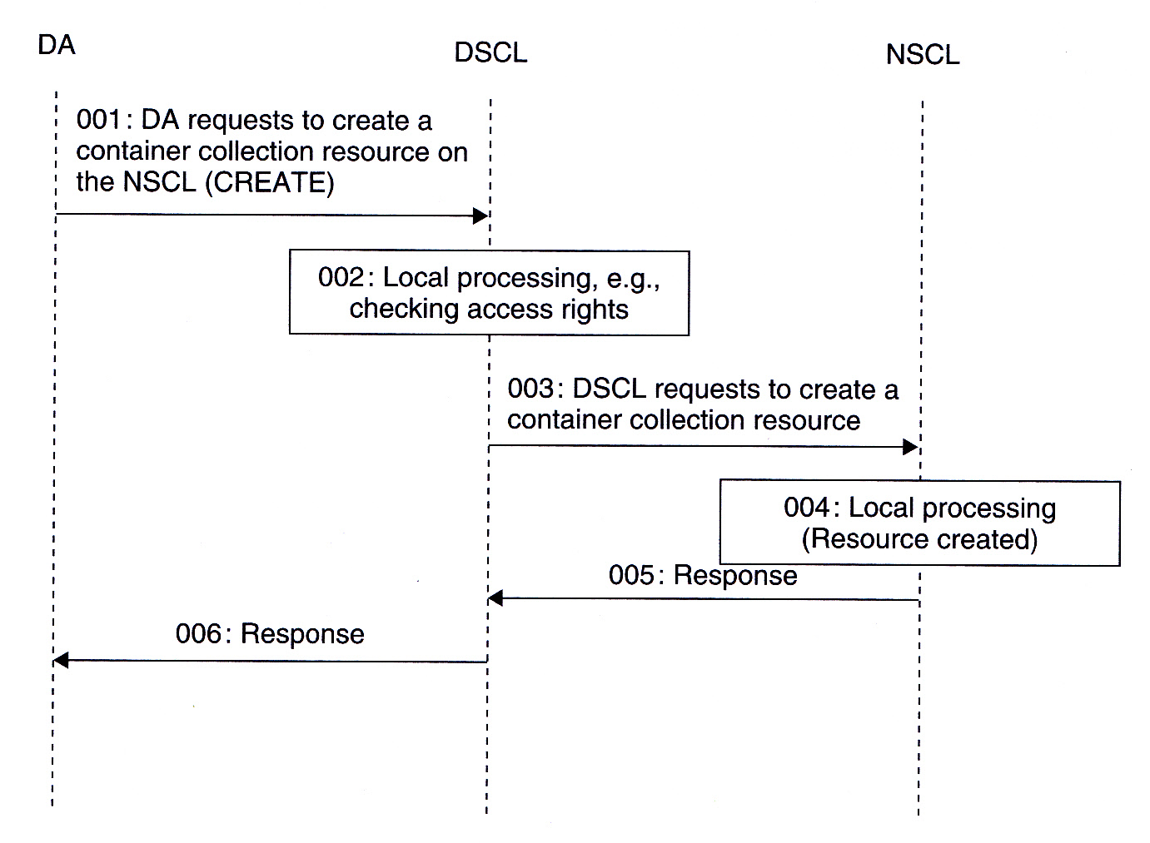
Step 9. DA Reports Meter Data to NSCL (3)
Source: M2M Communications: A Systems Approach, Wiley, 2012
DA Creates Container Collection Resource (Option 2) on NSCL.

Slide 137
Step 9. DA Reports Meter Data to NSCL (4)
Finally, DA creates a container instance to store meter data to NSCL.
<protocol>://smartmetering.utility1.com/scls/meter12345/applications/meterData/containers/meterDataSamples/contentInstances

